Slide 1
Process, Threads and Scheduling
13 - hrs.
Kapil Dev Pant

Slide 2
Content
2.1 Process
2.1.1 The Process Model
2.1.2 Process Creation and Process Termination
2.1.3 Process Hierarchies
2.1.4 Process States
2.1.5 Implementation of Processes
2.2 Threads
2.2.1 Thread Usage
2.2.2 Threads Models (Many-to-one model, One-to-One Model, Many-to many model)
2.2.3 User Space and Kernel Space Threads
2.2.4 Hybrid Implementations
2.2.5 Difference between Threads and Processes

Slide 3
Content
2.3 Inter-process Communication
2.3.1 Race Conditions
2.3.2 Critical Regions
2.3.3 Mutual Exclusion with Busy Waiting
2.3.4 Sleep and Wakeup, Semaphores, Mutexes, Monitors, Message Passing
2.3.9 Avoiding Locks: Read-Copy-Update
2.4 Process Scheduling
2.4.1 Basic Concept
2.4.2 Type of scheduling (Preemptive scheduling, Non-preemptive scheduling, batch, Interactive, real-time scheduling),
2.4.3 Scheduling Criteria or performance analysis, Scheduling Algorithm (Round-robin, First come first served, Shortest-job- first, Shortest process next, Shortest remaining Time next, real time, priority fair share, guaranteed, Lottery scheduling)

Slide 4
Content
2.5 Deadlocks
2.51 System Resources: Preemptable and Non-preemptable
2.5.2 Method of handling Deadlocks,
2.5.3 Deadlock prevention
2.5.4 Deadlock avoidance: Banker’s Algorithm,
2.5.5 Protection- System Protection, Goals of Protection, Principles of Protection, Domain of Protection, Access Matrix, Implementation of Access Matrix, access Control list
2.6 Research on Processes and Threads

Slide 5
Process
A process is a program in execution.
It is an active entity, unlike a passive program on disk.
A process includes:
Program code
Program counter (next instruction)
Stack (temporary data)Heap (dynamic memory)
Data section (global variables)
Example: Multiple Processes Running the Same Program
Suppose you open three instances of Microsoft Word (winword.exe).
The same program file is loaded each time.
The operating system creates three separate processes, each with:
Its own memory space
Separate data and stack
Independent execution flow

Slide 6
Process VS Program
Program: a static file on disk — source or executable — containing instructions
and maybe static data.
Process: a dynamic, runtime instance of a program — with its own CPU state,
memory, and OS bookkeeping — created when the program is executed.
Aspect | Program | Process
Definition | A program is a set of instructions written to perform a specific task. | A process is a program in execution, i.e., an active entity using CPU and memory resources.
Nature | Passive — it exists as a file stored on disk. | Active — it has a program counter, registers, stack, and allocated resources.
Lifespan | Exists permanently until deleted. | Exists temporarily — created when executed, terminated when finished.
Components | Contains only code (text segment). | Contains code, data, stack, and heap segments.
State | No state — just static instructions. | Has states — New, Ready, Running, Waiting, Terminated.
Example | chrome.exe file stored on disk. | Each running Chrome window or tab is a separate process.

Slide 7
The Process Model
The process model treats each process as an independent entity.
Each process runs in its own address space.
Processes communicate via:
Inter-Process Communication (IPC) mechanisms
Message passing or shared memory
Kernel manages all processes through the Process Control Block (PCB).
Notes:
Core components
Process:
A program in execution, which includes its code, data, stack, and other resources.
Process Control Block (PCB):
A data structure that stores all the information about a process, such as its ID, state, CPU registers, and memory usage.

Slide 8
Process Creation and Process Termination
Processes are created by other processes using system calls like fork() or CreateProcess().
Parent process creates a child process for multitasking.
Steps in creation:
Allocate memory for new process
Load program into memory
Initialize PCB
Add to ready queue
Reasons for creation:
System initialization
User request
Batch job initiation
Providing services
A process terminates when:
It finishes execution (exit())
Memory deficit
Excess time in execution
IO failure
Protection error
Misuse of data
It is killed (kill() or terminateProcess())
Parent or system shuts it down
Steps in termination:
OS updates PCB
Releases allocated resources
Removes process from all queues
Notes:
Program: exists until file deletion — persistent.
Process: ephemeral — created at runtime (via exec, fork, or process creation API), uses resources while active, and the OS reclaims resources at termination.
Creation steps (typical):
Kernel allocates a PCB and kernel structures.
Kernel creates address space (pages) and loads code (or maps the executable).
Initialize stack, heap, registers, file descriptors (inherited or new).
Put process in the ready queue for the scheduler.
Termination steps:
Process executes exit() (or killed).
Kernel updates PCB and frees resources (memory, file descriptors).
Parent may wait() to collect exit status (prevents zombies).
Process Creation
Definition:
Process creation is the initialization of a new process by the operating system. It involves allocating resources, setting up memory, and linking it to the process hierarchy.
Typical reasons for creation:
System startup (creating background/system processes)
User request (launching an application)
Batch job submission
Another process using system calls like:
fork() in UNIX/Linux
CreateProcess() in Windows
Steps Involved:
Assign Process ID (PID): OS assigns a unique identifier to the new process.
Allocate PCB (Process Control Block): A PCB structure is created to store the process state, program counter, CPU registers, etc.
Allocate Memory Space: OS allocates memory for:
Code (text segment)
Data (global variables)
Heap and Stack
Load Program: The executable file is loaded into memory.
Initialize I/O and File Descriptors: File handles, input/output streams, and environment variables are set.
Set Initial Process State: The process is placed in the Ready Queue.
Link to Parent Process: Parent-child relationship is established (process hierarchy).
Example:
In UNIX,
bash (parent) → fork() → child process → exec() → loads program
🧭 2️⃣ Process Scheduling
Definition:
Process scheduling determines which process gets CPU time next among those ready to run.
Purpose:
Efficient CPU utilization
Fairness among processes
Responsiveness for interactive tasks
Key Components:
Long-term scheduler (Job Scheduler): Decides which new processes to admit into the ready queue.
Short-term scheduler (CPU Scheduler): Chooses among ready processes for CPU execution.
Medium-term scheduler: Handles swapping (suspending/resuming processes) to manage memory.
Scheduling Criteria:
CPU utilization
Throughput
Turnaround time
Waiting time
Response time
Scheduling Algorithms:
FCFS (First Come First Served)
SJF (Shortest Job First)
Round Robin (RR)
Priority Scheduling
Multilevel Queue Scheduling
💻 3️⃣ Process Execution
Definition:
Process execution is when the CPU fetches, decodes, and executes instructions from the process.
Details:
The CPU fetches instructions from the process’s code segment.
Each process executes in User Mode (restricted access).
When the process needs an OS service, it makes a System Call, switching temporarily to Kernel Mode.
Execution Phases:
Ready → Running: Scheduler dispatches the process.
Running: CPU executes instructions.
Waiting (Blocked): Process waits for I/O or event.
Running → Terminated: Execution completes or is killed.
Example:
When you open a document:
The process executes file I/O (system calls)
Waits for I/O completion
Resumes execution after data is ready
🔄 4️⃣ Process Switching (Context Switching)
Definition:
Context switching is the mechanism of saving the state of one process and loading the state of another so the CPU can switch execution.
When it occurs:
Process yields CPU voluntarily (e.g., sleep() or I/O wait)
Higher priority process arrives (preemption)
Time slice expires (Round Robin)
Interrupt occurs
Steps Involved:
Save Context of Current Process:
Save CPU registers, program counter, stack pointer, and state into PCB.
Update PCB:
Mark process as Ready or Waiting.
Select Next Process:
CPU scheduler chooses next process from ready queue.
Load Context of Next Process:
Restore saved state (registers, program counter) from its PCB.
Transfer Control:
CPU resumes execution of the new process.
Key Data Structure:
Process Control Block (PCB): Holds all context information for restoration.
Note:
Context switching is overhead — no useful work is done during the switch, so OS minimizes it.
🧨 5️⃣ Process Termination
Definition:
Termination is the process of ending execution and releasing all allocated resources.
Reasons for termination:
Normal completion (exit() or program end)
Error or exception
Parent process request
Resource limit exceeded
System shutdown or kill signal
Steps Involved:
Process Issues Exit Request:
Calls exit() system call (or receives kill signal).
Kernel Actions:
Updates process state to Terminated.
Releases CPU and memory.
Closes open files, devices, and I/O buffers.
Parent Notification:
Parent process is notified (via wait() system call in UNIX).
PCB Deletion:
Kernel removes the PCB from process table.
Aftermath:
If parent doesn’t collect exit status → process becomes a zombie until wait() is called.
If parent terminates first → child becomes an orphan and is adopted by init or systemd.

Slide 9
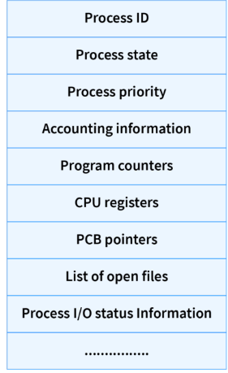
Process Control Block (PCB)
A data structure used by the OS to store process information.
PCB as the “identity card” of a process — stored in the kernel and updated during context switching.
Contains following for each process:
Process ID (PID)Process state
CPU registers
Program counter
Memory management info
I/O status & accounting info
Role of PCB in OS
State Management:
Resource Allocation:
Execution Oversight:
Protection and Security:
Context Information:
Notes:
Process ID:
When a new process is created by the user, the operating system assigns a unique ID i.e. a process-ID to that process. This ID helps the process to be distinguished from other processes existing in the system.
The operating system has a limit on the maximum number of processes it is capable of dealing with, let's say the OS can handle most N processes at a time.
Process State:
A process, from its creation to completion goes through different states. Generally, a process may be present in one of the 5 states during its execution:
Process Priority:
Process priority is a numeric value that represents the priority of each process. The lesser the value, the greater the priority of that process. This priority is assigned at the time of the creation of the PCB and may depend on many factors like the age of that process, the resources consumed, and so on. The user can also externally assign a priority to the process.
4. Process Accounting Information:
This attribute gives information on the resources used by that process in its lifetime. For Example: CPU time connection time, etc.
5. Program Counter:
The program counter is a pointer that points to the next instruction in the program to be executed. This attribute of PCB contains the address of the next instruction to be executed in the process.
6. CPU registers:
A CPU register is a quickly accessible small-sized location available to the CPU. These registers are stored in virtual memory (RAM)`.
6. Context Switching:
Context switching is a process that involves switching the CPU from one process or task to another. It is the process of storing the state of a process so that it can be restored and resume execution at a later point. This allows multiple processes to share a single CPU and is an essential feature of a multitasking operating system.
So, whenever context switching occurs in the code execution the current state of that process is stored temporarily in CPU registers. This helps in the fast execution of the process by not wasting time-saving and retrieving state information from the secondary memory(hard disk).
8. PCB pointer:
This field contains the address of the next PCB, which is in ready state. This helps the operating system to hierarchically maintain an easy control flow between parent processes and child processes.
9. List of open files:
As the name suggests, It contains information on all the files that are used by that process. This field is important as it helps the operating system to close all the opened files at the termination state of the process.
10. Process I/O information:
In this field, the list of all the input/output devices that are required by that process during its execution is mentioned.
Role of Process Control Block in OS Managing Process Execution and Resource Allocation
State Management: PCB in OS consistently tracks and updates the current state of a process (e.g., running, ready, or blocked).
Resource Allocation: Using details stored in the PCB in OS, the system efficiently assigns and monitors resources like memory and I/O devices to specific processes.
Execution Oversight: PCB in OS houses the program counter and CPU registers, ensuring processes execute correctly by pointing to the next instruction and maintaining intermediate data.
Protection and Security: By tracking allocated resources and memory boundaries in the PCB in OS, it prevents processes from interfering with each other or accessing unauthorized resources.
Context Information: During context switches, the PCB in OS stores the current context of a process, ensuring seamless transitions and allowing processes to resume where they left off.

Slide 10
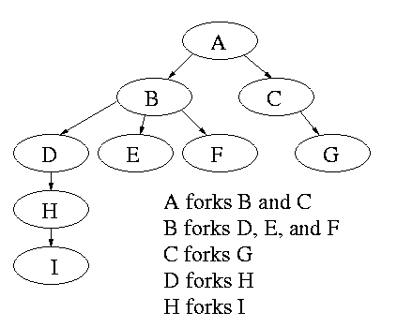
Process Hierarchies
Parent and child processes form a tree-like hierarchy.
UNIX/Linux: Child inherits environment and resources.
Parent can:
Wait for child to complete (wait() system call)
Create independent child
If parent terminates → children may become orphans.

Slide 11
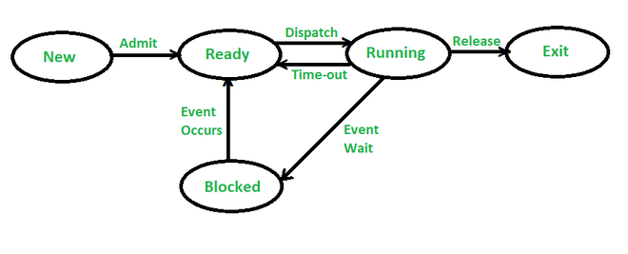
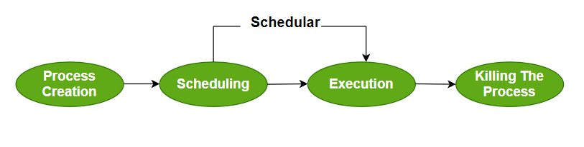
Process States
Process states:
New – being created
Ready – waiting for CPU
Running – instructions executing
Waiting/Blocked – waiting for I/O
Terminated – finished execution
State transitions occur due to scheduling or I/O.
Process Operations
It refers to the various activities the OS performs to manage processes.
Notes:
New:
The process has been created but has not yet been admitted to the pool of executable processes.
Ready:
The process is in main memory and is prepared to run as soon as the CPU is available.
Running:
The process is currently being executed by the CPU.
Blocked (or Waiting):
The process is waiting for some event to occur, such as the completion of an I/O operation or the availability of a resource.
Exit (or Terminated):
The process has finished its execution, either normally or due to an error.
When a new process is created, it is initially in the New state.
The OS moves the process to the Ready state once it is admitted to the main memory.
The OS's scheduler selects a process from the ready queue to run on the CPU, moving it to the Running state.
While running, the process might have to wait for an event (like I/O) and move to the Blocked state.
If a running process's time slice is up, it may be moved back to the Ready state to wait for another turn on the CPU.
When the process finishes, it is moved to the Exit state, and the OS deallocates its resources.

Slide 12
Implementation of Processes
the implementation of processes involves creating and managing units of execution that can run independently
OS maintains process data using:
Process Table (array of PCBs)
Scheduler (decides which process runs next)
Context Switching Mechanism
Context switch:
Save current process state
Load next process state
Update PCB accordingly
Implemented mostly in kernel mode
Implementation Steps: Example
Process Creation: launching app
Process Scheduling: which app gets cpu
Process Execution: app working
Process Switching : switching between apps
Process Termination: closing app
“Processes give isolation but require explicit mechanisms to share data; threads ease sharing but reduce fault isolation.”
Are processes isolated ?
Notes:
Phase Purpose Main OS Activity Key DataStructure
Creation Create a new process Allocate memory, initialize PCBPCB, Ready Queue
Scheduling Choose next process Use scheduling algorithms Ready Queue
Execution Run process on CPU Instruction fetch-decode-execute CPU Registers
Switching Change active process Save/restore context PCB
Termination End process, free resources Release memory, delete PCB Process Table
Address space & memory layout — why processes are isolated
Each process typically has its own virtual address space. Virtual memory maps the process’s logical addresses to physical frames.
Typical layout:
High addresses → stack (grows down)
Heap (grows up)
BSS (uninitialized globals)
Data (initialized globals)
Text (code, read-only)
Isolation benefits:
Faults in one process (segfault) don’t corrupt others.
Security: private data isn’t exposed.
OS can enforce permissions per-process.
1. What is Process Isolation?
Definition: Process isolation is the mechanism by which the operating system prevents one process from directly accessing or modifying the memory and resources of another process.
Purpose:
To protect processes from each other (so that one process’s failure doesn’t crash others).
To secure data and prevent unauthorized access.
To ensure stability and fault containment in multitasking systems.
⚙️ 2. Why Isolation is Needed
ReasonExplanationProtectionPrevents accidental or malicious modification of another process’s data.ReliabilityKeeps system stable — one process crash doesn’t affect others.SecurityStops sensitive information from leaking between processes.Resource ManagementPrevents one process from monopolizing CPU, memory, or I/O.
🧩 3. How the OS Achieves Process Isolation
The OS uses hardware and software mechanisms to isolate processes.
a) Separate Virtual Address Spaces
Each process gets its own virtual memory space.
The OS uses the Memory Management Unit (MMU) and page tables to map each process’s virtual addresses to physical memory.
A process cannot see or modify another’s memory, because its address translation is private.
🧠 Example: Process A’s address 0x2000 might map to physical frame 100, while Process B’s address 0x2000 maps to frame 350 — completely different memory areas.
b) CPU Privilege Levels
Modern CPUs support user mode and kernel mode.
User mode: Processes run with limited privileges — cannot directly access hardware or other processes’ memory.
Kernel mode: Only the OS runs here and can manage shared resources.
Any process trying to perform restricted actions must request the OS via a system call.
c) Process Control Blocks (PCBs)
Each process has its own PCB in kernel memory that stores:
Process ID, state, register values, and memory maps.
OS ensures no direct access by other processes — only the kernel can read or modify PCBs.
d) File and Resource Permissions
OS enforces access control lists (ACLs) or permission bits on files, devices, and sockets.
A process can only open or modify resources it is permitted to.
e) Context Switching
During context switching, the OS saves one process’s state and loads another’s.
The new process runs with its own registers, stack, and address space, ensuring no mixing of data.
🔗 4. Controlled Inter-Process Communication (IPC)
Since isolated processes cannot directly share memory, the OS provides controlled communication mechanisms, ensuring security and synchronization.
a) Message Passing
Processes communicate by sending and receiving messages through the kernel.
Mechanisms:
Pipes / FIFOs: Unidirectional or bidirectional data channels.
Message Queues: Structured communication via kernel-managed buffers.
Sockets: Network-based or local interprocess communication.
🧠 Example: A shell pipeline like ls | grep txt — here ls and grep are separate processes connected by a pipe.
b) Shared Memory
OS allows two or more processes to map a region of memory that is shared.
Communication is fast but requires synchronization (mutexes, semaphores) to prevent race conditions.
c) Signals
Asynchronous notifications sent by one process to another (e.g., SIGINT, SIGTERM).
Used for control and coordination, not bulk data transfer.
d) Semaphores and Monitors
Used to control synchronized access to shared resources.
OS enforces locking and mutual exclusion to prevent inconsistent states.
🧠 5. Example Scenario
Suppose you open two programs:
MS Word and Calculator Both are separate processes with isolated address spaces.
Word crash will not corrupt Calculator’s memory.
If they need to communicate (e.g., via clipboard), it’s done through controlled OS services (Windows Clipboard Manager), not direct memory access.
🔒 6. Summary
ConceptExplanationIsolationEach process runs independently, with its own memory and resources.EnforcementAchieved via virtual memory, privilege modes, and OS-managed PCBs.Controlled CommunicationIPC mechanisms (pipes, queues, shared memory, sockets) enable safe data exchange.GoalProtection, stability, and secure multitasking.
🎯 Analogy
Think of your computer as an apartment building:
Each process is a tenant with its own apartment (memory space).
Tenants can’t enter each other’s apartments (isolation).
They can talk through intercoms (IPC) under building management’s (OS’s) supervision.

Slide 13
Multiple processes executing the same program
When you launch the same executable multiple times, the OS creates separate processes; each gets:
Its own PCB and PID.
Its own stack, heap, and virtual memory mappings.
Its own set of registers and PC.
Shared elements (efficiently):
The executable’s text (code) pages are usually mapped read-only and shared between processes to save memory.
Shared libraries (dynamic libs) can be mapped into multiple processes.
Copy-on-Write (COW):
On fork() the child often starts as a copy of the parent’s address space, but the kernel marks pages read-only and sets up COW. Physical pages are shared until either process writes to a page — then the kernel copies that page so each process has its own copy. This makes process creation fast and memory-efficient.
Copy-on-write saves memory and makes fork() cheap: only when modification happens is memory physically duplicated.
Notes:
Concurrency implications (when multiple processes run same program)
Because each process has separate memory, data races only happen if processes explicitly share memory or synchronize via IPC. But shared resources (files, devices) can still cause contention.
Inter-Process Communication (IPC) mechanisms:
Pipes, FIFOs, sockets, message queues, shared memory, signals, semaphores.
Shared memory offers best performance but requires synchronization (mutexes, semaphores).
Problems & considerations:
Race conditions: two processes update shared state without synchronization → incorrect results.
Deadlocks: multiple processes wait on resources held by each other.
Starvation: scheduling policies might starve a process.
Security: ensure processes don’t expose sensitive memory via shared pages or misused IPC.

Slide 14
Key takeouts
Program = static code on disk; Process = program in execution with runtime state.
Process includes PC, registers, stack, heap, file descriptors, and a PCB in kernel.
Multiple processes can run the same program concurrently; code pages are often shared; data pages are private or copy-on-write.
fork() duplicates a process; exec() replaces a process image with a new program.
IPC and synchronization are needed when processes share data; careful design avoids races, deadlocks, and security issues.
Choose processes for isolation; threads for lightweight shared-memory concurrency.

Slide 15
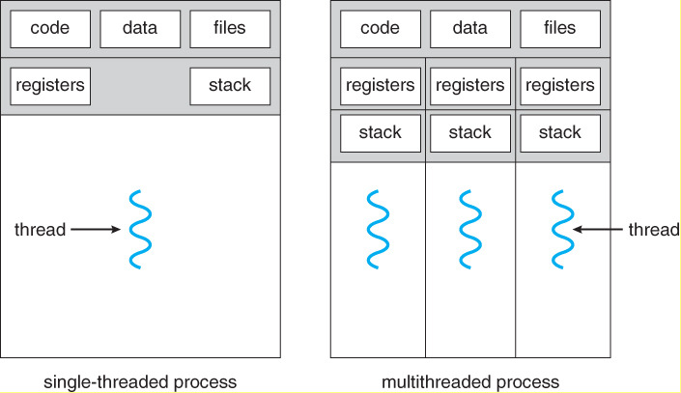
Threads
A thread is the smallest unit of CPU execution.
A thread is sometimes called a lightweight process.
Multiple threads can exist within the same process and share:
Code segment
Data segment
Files and resources
Each thread has its own registers, stack, and program counter.
Benefits? Responsiveness |Resource sharing | Economy | scalability
Notes:
There are four major categories of benefits to multi-threading:
Responsiveness - One thread may provide rapid response while other threads are blocked or slowed down doing intensive calculations.
Resource sharing - By default threads share common code, data, and other resources, which allows multiple tasks to be performed simultaneously in a single address space.
Economy - Creating and managing threads ( and context switches between them ) is much faster than performing the same tasks for processes.
Scalability, i.e. Utilization of multiprocessor architectures - A single threaded process can only run on one CPU, no matter how many may be available, whereas the execution of a multi-threaded application may be split amongst available processors. ( Note that single threaded processes can still benefit from multi-processor architectures when there are multiple processes contending for the CPU, i.e. when the load average is above some certain threshold. )

Slide 16
Difference between Threads and Processes
Process: heavier-weight; separate address spaces; strong isolation.
Thread: a lightweight unit of execution that shares the process’s address space with other threads in the same process.
When same program but multiple executions required:
Use multiple processes when you need isolation (crash robustness, separate privileges).
Use threads within a process when you need low-overhead concurrency and fast shared-memory communication.
Modern browsers use a mix: a process per tab (isolation) and multiple threads inside a tab (UI, rendering).
Example: Web browser (Chrome.exe)
Program: chrome.exe
Processes: one for each tab/site (often), renderer processes, GPU process.
Benefits: tab crash isolation, security sandboxing.

Slide 17
Thread Usage
Threads increase responsiveness — background tasks continue even if one thread blocks.
Improves resource sharing 🡪 threads in the same process share memory.
Enables economy 🡪 less overhead than creating new processes.
Supports multiprocessor utilization 🡪 multiple threads can run in parallel on multiple CPUs.
Examples:
Web servers use multiple threads to handle multiple clients.
Word processors: one thread for user input, another for spell checking.
Explain how multithreading enhances user experience and performance ?
Notes:
Explain how multithreading enhances user experience and performance ?
Multithreading enhances user experience and performance by allowing a program to execute multiple parts or threads concurrently. This concurrency provides a range of benefits in modern computing environments.
Enhanced User Experience (UX)
Multithreading improves the user experience primarily by maintaining application responsiveness and preventing the user interface (UI) from freezing.
Responsive User Interface: A key benefit is that long-running operations (like saving a large file, complex calculations, or fetching data from a network) can be moved to a separate "background" thread. The "main" UI thread remains free to handle user inputs like button clicks, scrolling, and keyboard entry, ensuring the application feels smooth and snappy
Faster Loading Times: Applications can use multiple threads to load different assets simultaneously. For example, a web browser might use one thread to download HTML, another to download images, and another for scripts, leading to faster webpage display .
Seamless Multimedia: In media players or video games, one thread can handle decoding audio, another can handle video rendering, and another might manage user controls. This separation prevents a momentary lag in one task from interrupting the smooth playback of others .
Perceived Performance: Even if the overall task completion time is similar, the ability to interact with the application while work is being done in the background makes the program feel faster and more efficient to the user .
Enhanced Performance
Multithreading leverages modern hardware to achieve genuine performance improvements, particularly on systems with multiple CPU cores.
Parallel Execution: With multi-core processors, the operating system can run different threads on different CPU cores simultaneously. This true parallelism speeds up tasks that can be broken into independent parts, such as complex mathematical calculations, data processing, or rendering high-resolution graphics .
Improved Resource Utilization: Instead of one CPU core sitting idle while waiting for data from memory or a network, other cores can be actively executing different threads, making better use of the available hardware resources
Reduced Latency: By allowing critical tasks to run in parallel with less important ones, multithreading helps in reducing the time a user has to wait for a specific action to complete .
In summary, multithreading is a foundational technique that makes software more efficient, faster, and more enjoyable to use by enabling concurrent operations and effective utilization of modern hardware.

Slide 18
Benefits of Multithreading
Multithreading means a single process is divided into multiple threads, where each thread runs independently but shares the same memory and resources of the process.
How ?
Responsiveness – UI does not freeze
Resource sharing – threads share memory
Better throughput – more tasks finished
Lower overhead – cheaper than processes
Parallelism – uses multi-core CPU fully
Concurrency – efficient switching
Faster context switching
Improved performance for I/O tasks
Scalability – handles more workload
Notes:
Improved Responsiveness
In a multithreaded application, if one thread is blocked (e.g., waiting for I/O), other threads can continue executing.
This makes applications more responsive to users. Example: In a web browser, one thread loads a page while another thread handles user clicks.
2. Resource Sharing
Threads of the same process share memory, code, data, and files, reducing the need for duplication.
This makes communication between threads fast and efficient compared to communication between processes.
3. Faster Execution / Increased Throughput
Multiple threads running in parallel lead to better CPU utilization.
More tasks are completed in a given time. Example: A web server serving 1000 clients using 1000 threads is faster than using 1000 separate processes.
4. Lower Overhead Compared to Processes
Creating a thread requires fewer resources than creating a full process.
Context switching between threads is faster than between processes because:
Threads share memory
No need to switch address space completely Result → Lower overhead and higher performance.
5. Parallelism on Multi-core Systems
Multithreading allows programs to run multiple threads simultaneously on different CPU cores.
This leads to true parallel execution. Example: Video editing software uses multiple threads to encode videos faster.
6. Better Utilization of CPU (Concurrency)
Even on single-core systems, threads provide concurrency by switching between tasks quickly.
CPU never stays idle if another thread is ready to run.
7. Simplifies Structure of Complex Applications
Tasks like:
Listening to incoming requests
Processing data
Updating UI
Handling background tasks can all be done by separate threads.
This makes the program easier to design, debug, and manage.
8. Enhanced Performance in I/O-bound Programs
When one thread waits for disk, network, or user input, other threads can run.
Reduces idle time and improves overall efficiency.
9. Scalability
Multithreaded programs can scale better with increasing workload.
More threads can be added as hardware improves (more cores), without rewriting the entire program.
10. Cost-Effective
Since threads share most of their resources, the operating system:
Saves memory
Reduces CPU time
Minimizes context-switching cost Compared to using multiple processes

Slide 19
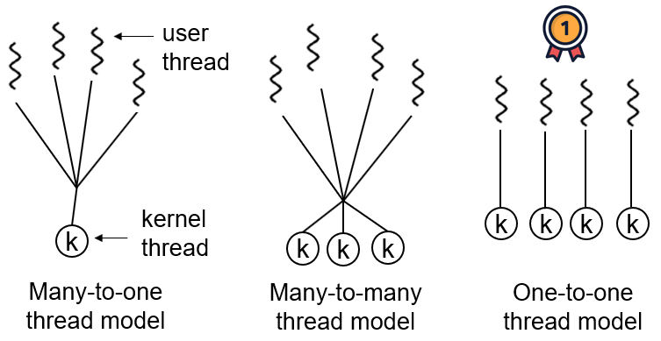
Threads Models
Three main multithreading models:
Many-to-one model
One-to-One Model
Many-to many model
Notes:
User-Level Threads (ULT):
Managed entirely by user-space libraries (not by the OS kernel).
The kernel is unaware that multiple threads exist inside a process.
Operations like creation, synchronization, and scheduling happen without system calls.
Kernel-Level Threads (KLT):
Managed directly by the operating system kernel.
The kernel schedules and executes each thread independently.
Each KLT has its own kernel data structures (like PCB extensions).
Why Mapping Is Needed
When a program uses threads, the OS must know how these user threads correspond to actual kernel threads that can run on CPUs. This mapping determines:
How much parallelism is possible
Who handles scheduling (library or OS)
How blocking and synchronization work
Imagine a restaurant kitchen:
Cooks (kernel threads) actually cook the food (execute).
Orders (user threads) are tasks to complete.
Depending on the model:
Many-to-One → One cook for all orders → slow if one order blocks.
One-to-One → One cook per order → fast but expensive.
Many-to-Many → Few cooks handle many orders efficiently → balanced system.

Slide 20
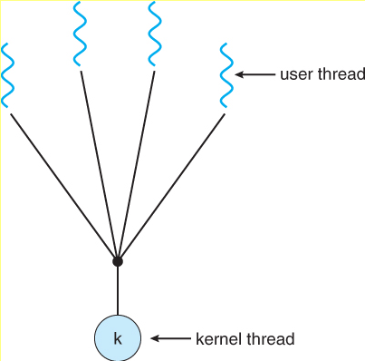
Many-to-one-model
Entire multithreading handled by the user thread library.
Many user-level threads are all mapped onto a single kernel thread. So The kernel sees only one thread (the whole process).
No true parallelism on multicore CPUs — only one thread runs at a time.
If one user thread blocks (e.g., I/O call), the whole process blocks.
Advantages:
Very fast thread operations (creation, switch).
No kernel mode involvement — efficient for small, cooperative tasks.
Disadvantages:
One thread’s blocking system call halts all.
Cannot utilize multiple cores.
Example Systems:
Early Java Green Threads
GNU Portable Threads (historical)

Slide 21
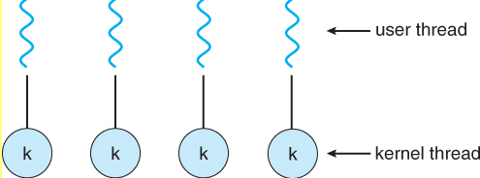
One to one model
Each user thread is backed by its own kernel thread.
OS manages and schedules all threads individually.
Enables true parallelism on multicore systems.
Each thread can block or run independently.
Advantages:
True concurrency across multiple CPUs.
If one thread blocks, others can continue.
Better fault isolation.
Disadvantages:
Higher overhead — creating many kernel threads consumes system resources.
Performance drops when thousands of threads exist.
Example Systems:
Windows threads from 95 to xp
Linux POSIX pthreads (NPTL implementation)
Java threads (modern JVMs)

Slide 22
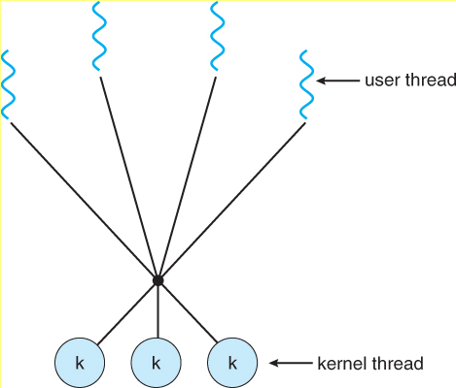
Many-to-many model
A pool of kernel threads executes many user threads.
User-level thread library schedules ULTs onto available KLTs.
Combines flexibility of user threads with true parallelism of kernel threads.
Advantages:
Efficient resource use.
User threads not tied 1:1 with kernel threads — reduces overhead.
Allows concurrency and scalability.
If one user thread blocks, others can still run (using other kernel threads).
Disadvantages:
More complex to implement and manage.
Requires coordination between thread library and OS.
Example Systems:
Solaris (older versions)
Windows Thread Pool
Modern JVMs and .NET frameworks

Slide 23
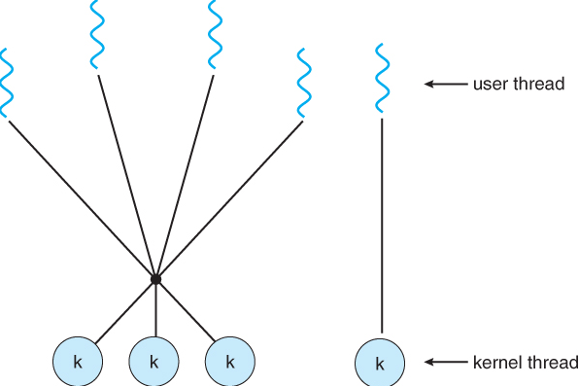
Hybrid or Two-Level Model (Variation)
A specialized Many-to-Many variant.
Application can bind certain user threads directly to kernel threads (1:1 mapping), while others are multiplexed.
Gives fine-grained control for performance-critical threads.
Example: Solaris 9, Windows with thread pools, and modern Linux pthreads use hybrid behavior.

Slide 24
User Space and Kernel Space Threads
User-Level Threads (ULT):
Managed entirely by user-space libraries (not by the OS kernel).
The kernel is unaware that multiple threads exist inside a process.
Operations like creation, synchronization, and scheduling happen without system calls.
Kernel-Level Threads (KLT):
Managed directly by the operating system kernel.
The kernel schedules and executes each thread independently.
Each KLT has its own kernel data structures (like PCB extensions).
Why Mapping Is Needed
When a program uses threads, the OS must know how these user threads correspond to actual kernel threads that can run on CPUs.
This mapping determines:
How much parallelism is possible
Who handles scheduling (library or OS)
How blocking and synchronization work

Slide 25
Hybrid Implementations
It combine the best aspects of both user-level and kernel-level threads to provide a more efficient and flexible approach to multithreading.
Key Features of Hybrid Models
Efficient Resource Utilization:
Non-Blocking:
Customizable Thread Scheduling:
Common Hybrid Thread Models
Many-to-Many (M:N) Model:
Advantages: Efficient resource utilization, non-blocking behavior, and customizable scheduling.
Example: Windows NT and later.
Two-Level Model:
Each process has one or more user-level threads.
Advantages: Improved performance and scalability compared to user-level threads, while still providing flexibility.
Example: Solaris.
Hybrid Thread Model Implementation
User-Level Threads:
Kernel-Level Threads:
Mapping
Advantages of Hybrid Thread Models
Efficient Resource Utilization:
Improved Performance:
Enhanced Responsiveness:
Increased Flexibility:

Slide 26
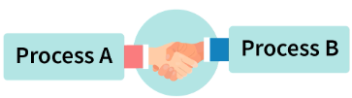
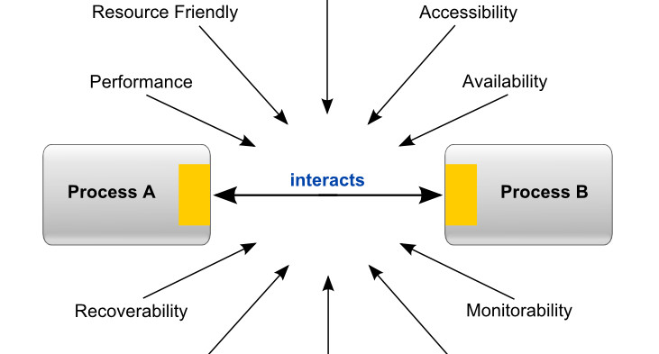
Inter-process Communication
IPC allows processes to exchange data and synchronize their actions.
Essential for multi-tasking, client-server, and distributed systems.
Objectives of IPC:
Data sharing between processes
Event notification and synchronization
Resource sharing
Modular and concurrent process design
Examples:
Producer-Consumer problem
Client-server communication via sockets or message queues

Slide 27
IPC Mechanisms
IPC ensures process coordination, data consistency, and efficient CPU use.
Synchronization tools evolve from simple locks to advanced lock-free mechanisms like RCU.
Proper IPC design prevents race conditions and improves system stability.
Why IPC is needed?
Sharing data.
Coordinating activities:
Managing resources:
Achieving modularity:
Flexibility:
Notes:
Pipes are a simple form of shared memory that allows two processes to communicate with each other.
It is a half duplex method (or one way communication) used for IPC between two related processes .
One process writes data to the pipe, and the other process reads data from the pipe.
It is like a scenario like filling water with a tap into a bucket. The filling process is writing into the pipe and the reading process is retrieving from the pipe.
Pipes can be either named or anonymous, depending on whether they have a unique name or not.
Named pipes are a type of pipe that has a unique name, and can be accessed by multiple processes. Named pipes can be used for communication between processes running on the same host or between processes running on different hosts over a network.
Anonymous pipes, on the other hand, are pipes that are created for communication between a parent process and its child process. Anonymous pipes are typically used for one-way communication between processes, as they do not have a unique name and can only be accessed by the processes that created them.
Key distinction:
Shared Memory: Fast, but requires synchronization.
Message Passing: Safer, but slower (involves system calls).

Slide 28
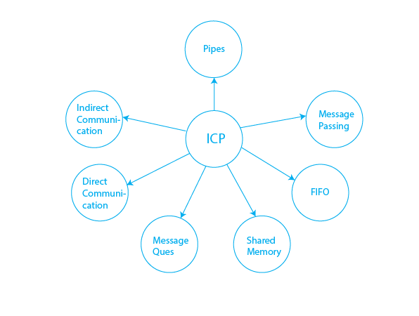
Common IPC Techniques
Shared Memory
Message Passing(Direct, Indirect)
Pipes (Unnamed and Named)
Synchronization tools (Semaphores, monitors, etc)
Advanced IPC techniques ( Pipes, Sockets, RPC)
Notes:
Pipes are a simple form of shared memory that allows two processes to communicate with each other.
It is a half duplex method (or one way communication) used for IPC between two related processes .
One process writes data to the pipe, and the other process reads data from the pipe.
It is like a scenario like filling water with a tap into a bucket. The filling process is writing into the pipe and the reading process is retrieving from the pipe.
Pipes can be either named or anonymous, depending on whether they have a unique name or not.
Named pipes are a type of pipe that has a unique name, and can be accessed by multiple processes. Named pipes can be used for communication between processes running on the same host or between processes running on different hosts over a network.
Anonymous pipes, on the other hand, are pipes that are created for communication between a parent process and its child process. Anonymous pipes are typically used for one-way communication between processes, as they do not have a unique name and can only be accessed by the processes that created them.
Key distinction:
Shared Memory: Fast, but requires synchronization.
Message Passing: Safer, but slower (involves system calls).

Slide 29
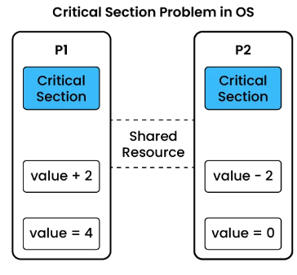
Critical Regions/ Section
A critical region (or section) is a part of the program where a shared resource is accessed.
Only one process should execute in its critical region at a time.
Conditions for Correct Synchronization (Coffman’s Conditions):
Mutual Exclusion: Only one process in the critical section.
Progress: No unnecessary delay for entering.
Bounded Waiting: No process waits indefinitely.
No Assumption of Speed: Works regardless of CPU speed/cores.
Notes:
🡪Mutual Exclusion – Only one process can access its critical section at a time. This prevents data corruption in shared resources by providing accurate access.
🡪Progress in Critical Section – ensures that if no process is currently inside its critical section, one of the waiting processes will eventually be allowed to enter without unnecessary delay.
🡪Bounded Waiting – A process should not be forced to wait indefinitely. There should be a statement in the record of how many processes could enter their critical section before the waiting process gets information that it can access its critical section.

Slide 30
Mutual Exclusion
"no two processes can exist in the critical section at any given point of time”
Notes:
During concurrent execution of processes, processes need to enter the critical section (or the section of the program shared across processes) at times for execution. It might happen that because of the execution of multiple processes at once, the values stored in the critical section become inconsistent. In other words, the values depend on the sequence of execution of instructions - also known as a race condition. The primary task of process synchronization is to get rid of race conditions while executing the critical section.
What is Mutual Exclusion?
Mutual Exclusion is a property of process synchronization that states that "no two processes can exist in the critical section at any given point of time". The term was first coined by Dijkstra. Any process synchronization technique being used must satisfy the property of mutual exclusion, without which it would not be possible to get rid of a race condition.
The need for mutual exclusion comes with concurrency. There are several kinds of concurrent execution:
Interrupt handlers
Interleaved, preemptively scheduled processes/threads
Multiprocessor clusters, with shared memory
Distributed systems
Mutual exclusion methods are used in concurrent programming to avoid the simultaneous use of a common resource, such as a global variable, by pieces of computer code called critical sections.
The requirement of mutual exclusion is that when process P1 is accessing a shared resource R1, another process should not be able to access resource R1 until process P1 has finished its operation with resource R1.
Examples of such resources include files, I/O devices such as printers, and shared data structures.
Conditions Required for Mutual Exclusion
According to the following four criteria, mutual exclusion is applicable:
When using shared resources, it is important to ensure mutual exclusion between various processes. There cannot be two processes running simultaneously in either of their critical sections.
It is not advisable to make assumptions about the relative speeds of the unstable processes.
For access to the critical section, a process that is outside of it must not obstruct another process.
Its critical section must be accessible by multiple processes in a finite amount of time; multiple processes should never be kept waiting in an infinite loop.
Approaches To Implementing Mutual Exclusion
Software Method: Leave the responsibility to the processes themselves. These methods are usually highly error-prone and carry high overheads.
Hardware Method: Special-purpose machine instructions are used for accessing shared resources. This method is faster but cannot provide a complete solution. Hardware solutions cannot give guarantee the absence of deadlock and starvation.
Programming Language Method: Provide support through the operating system or through the programming language.
Requirements of Mutual Exclusion
At any time, only one process is allowed to enter its critical section.
The solution is implemented purely in software on a machine.
A process remains inside its critical section for a bounded time only.
No assumption can be made about the relative speeds of asynchronous concurrent processes.
A process cannot prevent any other process from entering into a critical section.
A process must not be indefinitely postponed from entering its critical section.
In order to understand mutual exclusion, let's take an example.
What is a Need of Mutual Exclusion?
An easy way to visualize the significance of mutual exclusion is to imagine a linked list of several items, with the fourth and fifth items needing to be removed. By changing the previous node's next reference to point to the succeeding node, the node that lies between the other two nodes is deleted.
To put it simply, whenever node "i" wants to be removed, node "with - 1"'s subsequent reference is changed to point to node "ith + 1" at that time. Two distinct nodes can be removed by two threads at the same time when a shared linked list is being used by many threads. This occurs when the first thread modifies node "ith - 1" next reference, pointing towards the node "ith + 1," and the second thread modifies node "ith" next reference, pointing towards the node "ith + 2." Although both nodes have been removed, the linked list's required state has not yet been reached because node "i + 1" still exists in the list because node "ith - 1" next reference still points to it.
Now, this situation is called a race condition. Race conditions can be prevented by mutual exclusion so that updates at the same time cannot happen to the very bit about the list.
Example:
In the clothes section of a supermarket, two people are shopping for clothes.
Boy, A decides upon some clothes to buy and heads to the changing room to try them out. Now, while boy A is inside the changing room, there is an 'occupied' sign on it - indicating that no one else can come in. Boy B has to use the changing room too, so she has to wait till boy A is done using the changing room.
Once boy A comes out of the changing room, the sign on it changes from 'occupied' to 'vacant' - indicating that another person can use it. Hence, boy B proceeds to use the changing room, while the sign displays 'occupied' again.
The changing room is nothing but the critical section, boy A and boy B are two different processes, while the sign outside the changing room indicates the process synchronization mechanism being used.
Conclusion
In conclusion, mutual exclusion is a key concept in synchronization that ensures only one process accesses a shared resource at a time. This prevents conflicts and data corruption, making sure that processes run smoothly and correctly. By using mutual exclusion mechanisms, we can create stable and reliable systems that handle multiple processes efficiently.

Slide 31
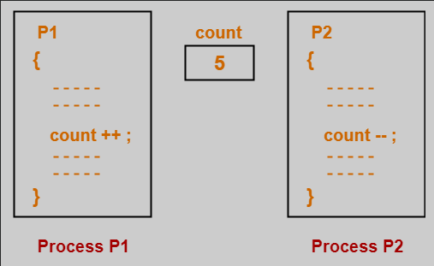
Race Conditions
A race condition occurs when multiple processes/threads access shared data concurrently, and the final result depends on the order of execution (Unpredictable and inconsistent outcomes).
Cause:
Lack of synchronization in accessing shared resources
Concurrent access to shared resources.
Non atomic operation
Improper scheduling
Notes:
Imagine two processes, A and B, trying to increment a shared counter variable count.
Initial state: count is 5.
Process A reads count: Process A reads the value 5 into a temporary variable.
Context switch: Before A can update count, the OS switches to process B.
Process B reads count: Process B also reads the value 5 into its own temporary variable.
Process B increments and writes: Process B increments its temporary variable to 6 and writes it back to count. Now, count is 6.
Context switch: The OS switches back to process A.
Process A increments and writes: Process A increments its temporary variable (which was also 5 to 6 and writes it back to count. Now, count is still 6
In this scenario, both processes performed an increment, but the final value of count is 6 instead of the expected 7. This is a race condition because the outcome depends on the non-deterministic timing of the process switches.

Slide 32
Preventing Race Conditions
Define critical sections to ensure one process accesses shared data at a time.
Implement mutual exclusion mechanisms (locks, semaphores, monitors).(Using synchronization primitives)
Follow proper synchronization protocols.
Ensure thread safe operations
Notes:
Prevention
Use synchronization primitives: Implement synchronization tools like locks, semaphores, mutexes, or atomic operations to ensure exclusive access to shared resources.
Define critical sections: Isolate the code segments that access shared resources into "critical sections" and protect them with synchronization mechanisms.
Ensure thread-safe operations: Design code so that it can be safely executed by multiple threads concurrently. This often involves using techniques to avoid shared mutable state or using thread-safe data structures.

Slide 33
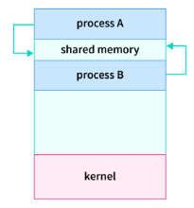
Shared Memory and Message passing
region of memory that is accessible to multiple processes
Allows communication by reading and writing data from the shared memory region
fast and efficient way for processes to communicate but difficult if not synchronized properly
Types:
Anonymous shared memory
Mapped shared memory
Notes:
Anonymous shared memory: Anonymous shared memory is not associated with any file or other system object. It is created by the operating system and is only accessible to the processes that created it.
Mapped shared memory: Mapped shared memory is associated with a file or other system object. It is created by mapping a file into the address space of one or more processes.
Multiple processes can access a common shared memory. Multiple processes communicate by shared memory, where one process makes changes at a time and then others view the change. Shared memory does not use kernel.

Slide 34
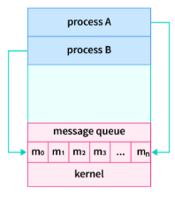
Message Passing
A synchronization and communication method where processes exchange messages instead of sharing memory.
Mechanisms:
send(destination, message)
receive(source, message)
Modes:
Direct / Indirect communication
Synchronous / Asynchronous
Example:
Used in client-server, microkernel OS (e.g., Minix), and distributed systems.
Notes:
Message passing is a method of Inter Process Communication in OS. It involves the exchange of messages between processes, where each process sends and receives messages to coordinate its activities and exchange data with other processes.
Processes can communicate without any shared variables; therefore it can be used in a distributed environment on a network.
In message passing, each process has a unique identifier, known as a process ID, and messages are sent from one process to another using this identifier. When a process sends a message, it specifies the recipient process ID and the contents of the message, and the operating system is responsible for delivering the message to the recipient process. The recipient process can then retrieve the contents of the message and respond, if necessary.
Message passing in shared memory has a number of advantages over other IPC mechanisms. First, it is very fast, as messages are simply copied from one process's address space to another. Second, it is very flexible, as any type of data can be shared between processes. Third, it is relatively easy to implement, as it does not require any special support from the operating system.
However, message passing in shared memory also has some disadvantages. First, it can be difficult to ensure that messages are delivered in the correct order. Second, it can be difficult to manage the size of the message queue. Third, it can be difficult to port to other platforms, as the implementation of shared memory can vary from one operating system to another.

Slide 35
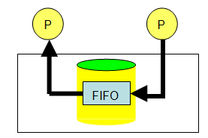

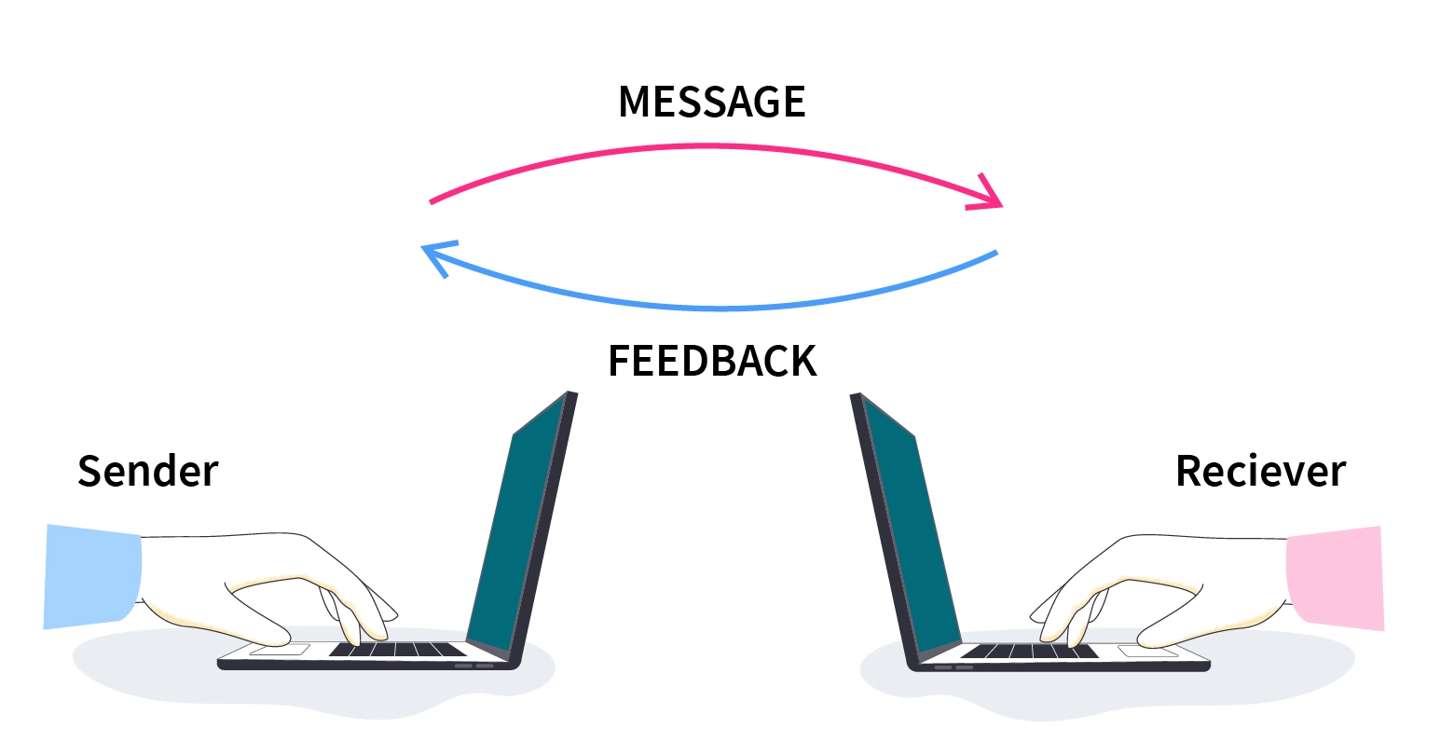
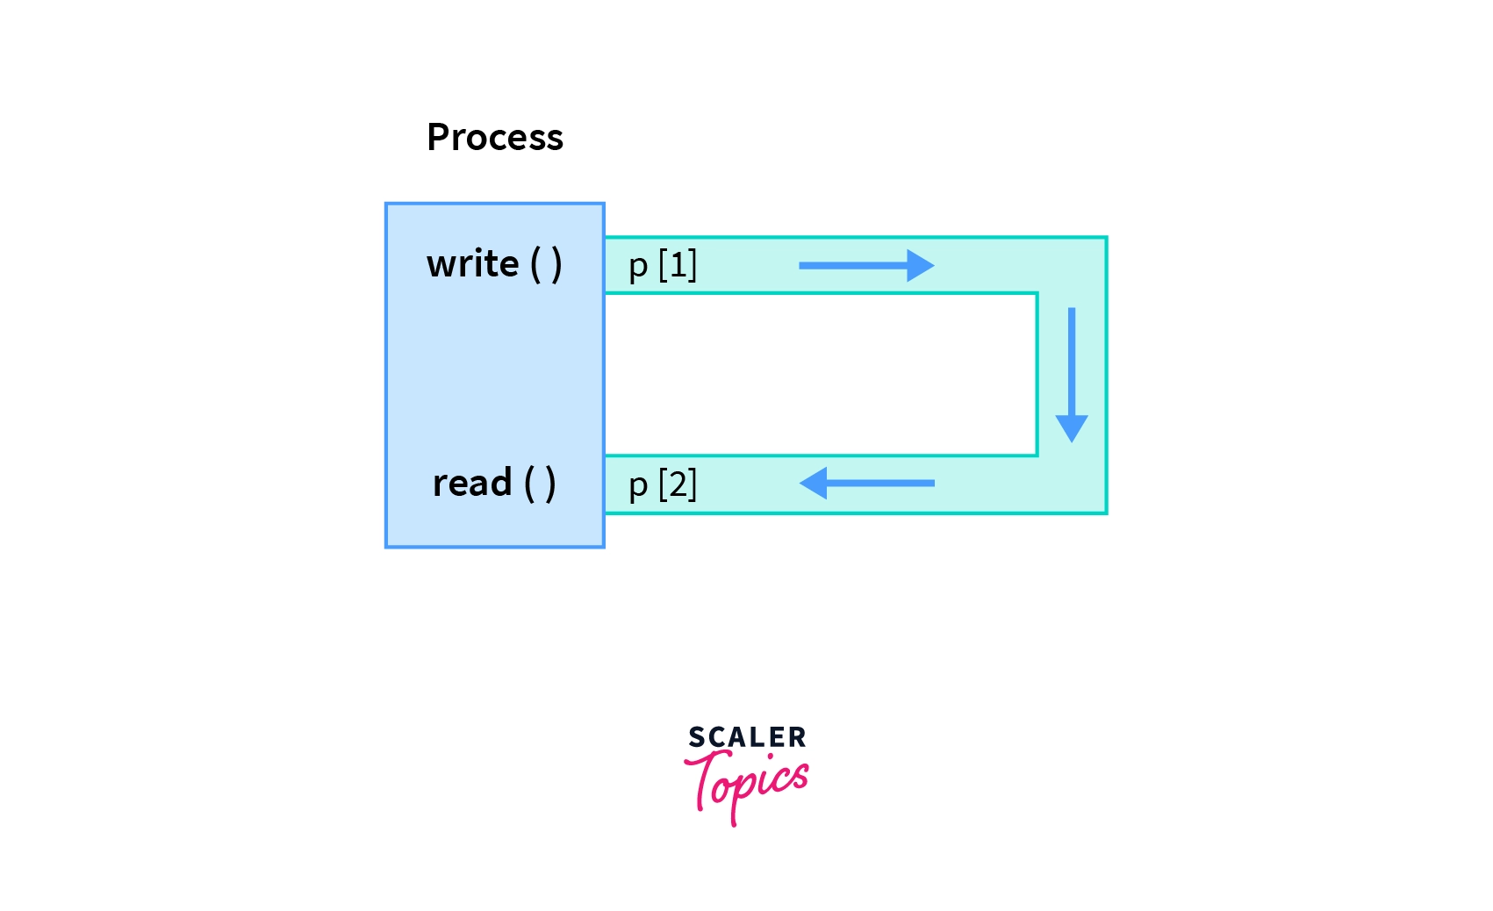
Other approaches

Slide 36
Synchronization in IPC
It is the process of ensuring that multiple processes are coordinated and do not interfere with each other.
If they are not synchronized, they can overwrite each other's data or cause other problems.
Mechanisms
Mutual exclusion:
Condition variables:
Barriers:
Semaphores:
Notes:
Mutual exclusion: This is a mechanism that ensures that only one process can access a shared resource at a time
Condition variables: These are variables that can be used to wait for a certain condition to be met.
Barriers: These are synchronization points that all processes must reach before they can proceed.
Semaphores: These are variables that can be used to count the number of times a shared resource is being used.

Slide 37
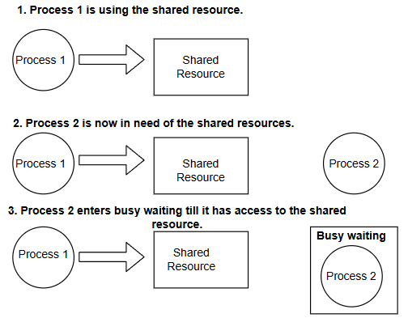
Mutual Exclusion with Busy Waiting
A synchronization method where a process repeatedly checks if a condition is true before entering its critical section.
Techniques:
Disabling Interrupts: Prevents context switching (used in kernel mode).
Lock Variables: Simple flags (inefficient).
Test-and-Set Lock (TSL): Hardware-based atomic instruction.
Peterson’s Algorithm: Software-based solution for two processes.
Notes:
algorithm delay(process p, resource z):
// INPUT
// p = Process that needs to be delayed
// z = Resource that the process is waiting for
// OUTPUT
// Puts the process 'p' to sleep while resource 'z' is in use
while z is still in use:
p.sleep(900)

Slide 38
Mutual Exclusion with Busy Waiting
Need of Busy Waiting:
Busy waiting is required in operating system for achieving mutual exclusion.
In the critical section of processes they are granted with exclusive control for accessing it’s resources without any interference from the other available processes in mutual exclusion.
Limitations of Busy Waiting:
Busy waiting keeps CPU busy at all the time until it’s condition gets satisfied.
The synchronization mechanism that makes use of busy waiting suffers from the problem of priority inversion.
In critical section the low priority processes gets executed.
The system remains idle when process is in busy waiting state.
Busy waiting consumes more power.

Slide 39
Sleep and Wakeup
A sleep system call puts a process to sleep (blocked) until another process issues a wakeup signal.
Example:
Used in Producer-Consumer Problem to avoid busy waiting.
Producer sleeps if buffer is full.
Consumer wakes producer when space is available.
Advantage:
Efficient CPU usage (no busy looping).
Notes:
There are two general approaches to waiting in operating systems: firstly, a process/task can continuously check for the condition to be satisfied while consuming the processor – busy waiting.
Secondly, a process can wait without consuming the processor. In such a case, the process/task is alerted or awakened when the condition is satisfied. The latter is known as sleeping, blocked waiting, or sleep waiting.

Slide 40
Producer-consumer Problem
Producer is a process which is able to produce data/item.
Consumer is a Process that is able to consume the data/item produced by the Producer.
Both Producer and Consumer share a common memory buffer.
Problem arises when
1. The producer wants to put a new data in the buffer, but buffer is already full.
Solution: Producer goes to sleep and to be awakened when the consumer has removed data.
2. The consumer wants to remove data the buffer but buffer is already empty.
Solution: Consumer goes to sleep until the producer puts some data in buffer and wakes consumer up.

Slide 41
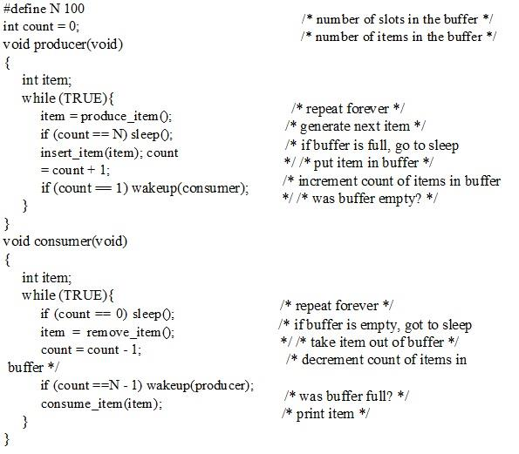
Producer consumer problem

Slide 42
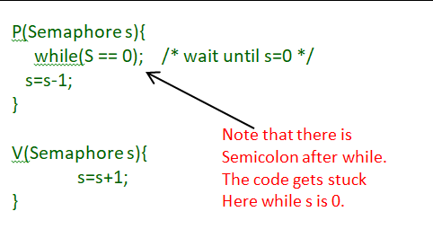
Semaphores
Semaphores means Signal bearer
A semaphore is a synchronization primitive used to control access to a shared resource.
Introduced by Edsger Dijkstra.
Types:
Binary Semaphore (Mutex): Value 0 or 1 (mutual exclusion).
Counting Semaphore: Allows multiple instances of a resource.
Operations:
wait(S) or P(S) → Decrement; block if S < 0
signal(S) or V(S) → Increment; wake a waiting process
Notes:
Semaphore is a simply a variable. This variable is used to solve critical section problem and to achieve process synchronization in the multiprocessing environment.
The two most common kinds of semaphores are counting semaphores and binary semaphores. Counting semaphore can take non-negative integer values and Binary semaphore can take the value 0 & 1 only.
A semaphore can only be accessed using the following operations:
wait () :- called when a process wants access to a resource
signal ():- called when a process is done using a resource
int s = 1;
wait (Semaphore s)
{
while (s==0); /* wait until s>0 */ s=s-1;
}
signal (Semaphore s)
{
s=s+1;
}
Here is an implementation of mutual-exclusion using binary semaphores:
do
{
wait(s);
// critical section
signal(s);
// remainder section
} while(1);
Now, let us see how it implements mutual exclusion. Let there be two processes P1 and P2 and a semaphore s is initialized as 1. Now if suppose P1 enters in its critical section then the value of semaphore s becomes 0. Now if P2 wants to enter its critical section then it will wait until s>0, this can only happen when P1 finishes its critical section and calls signal() operation on semaphore s. This way mutual exclusion is achieved. Look at the below image for details.
Historically, wait() was called signal() was called V i.e

Slide 43
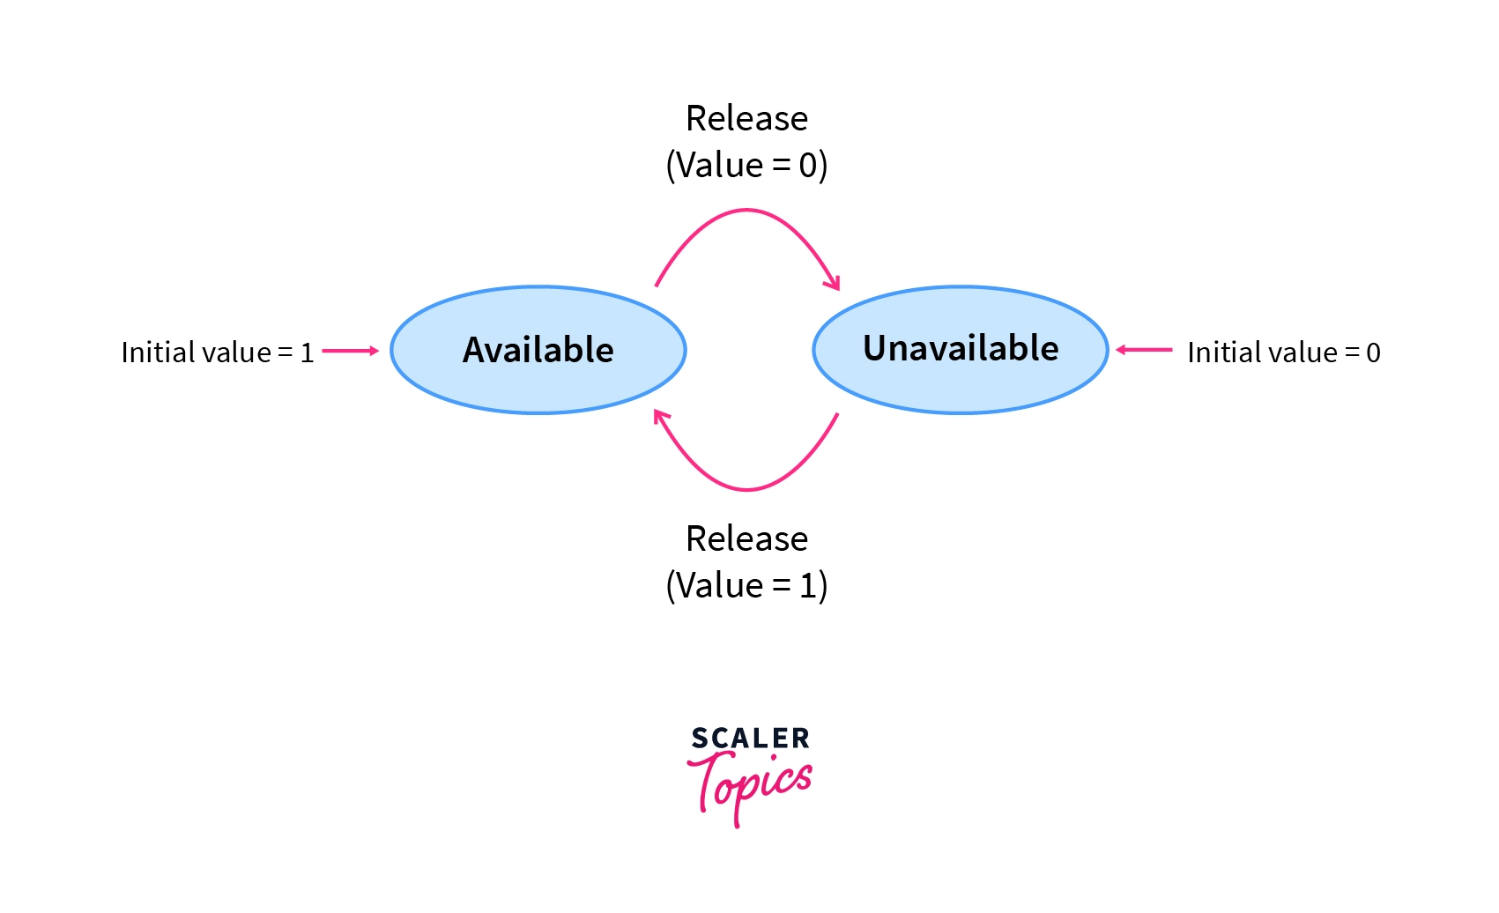
Binary Semaphores
In these types of Semaphores, the integer value of the semaphore can only be either 0 or 1.
If the value of the Semaphore is 1, it means that the process can proceed to the critical section
However, if the value of the binary semaphore is 0, then the process cannot continue to the critical section of the code.
When a process is in critical section, Semaphore value = 0, and when a process not in critical section, allow a process to access the critical section, we change the value of semaphore to 1.

Slide 44
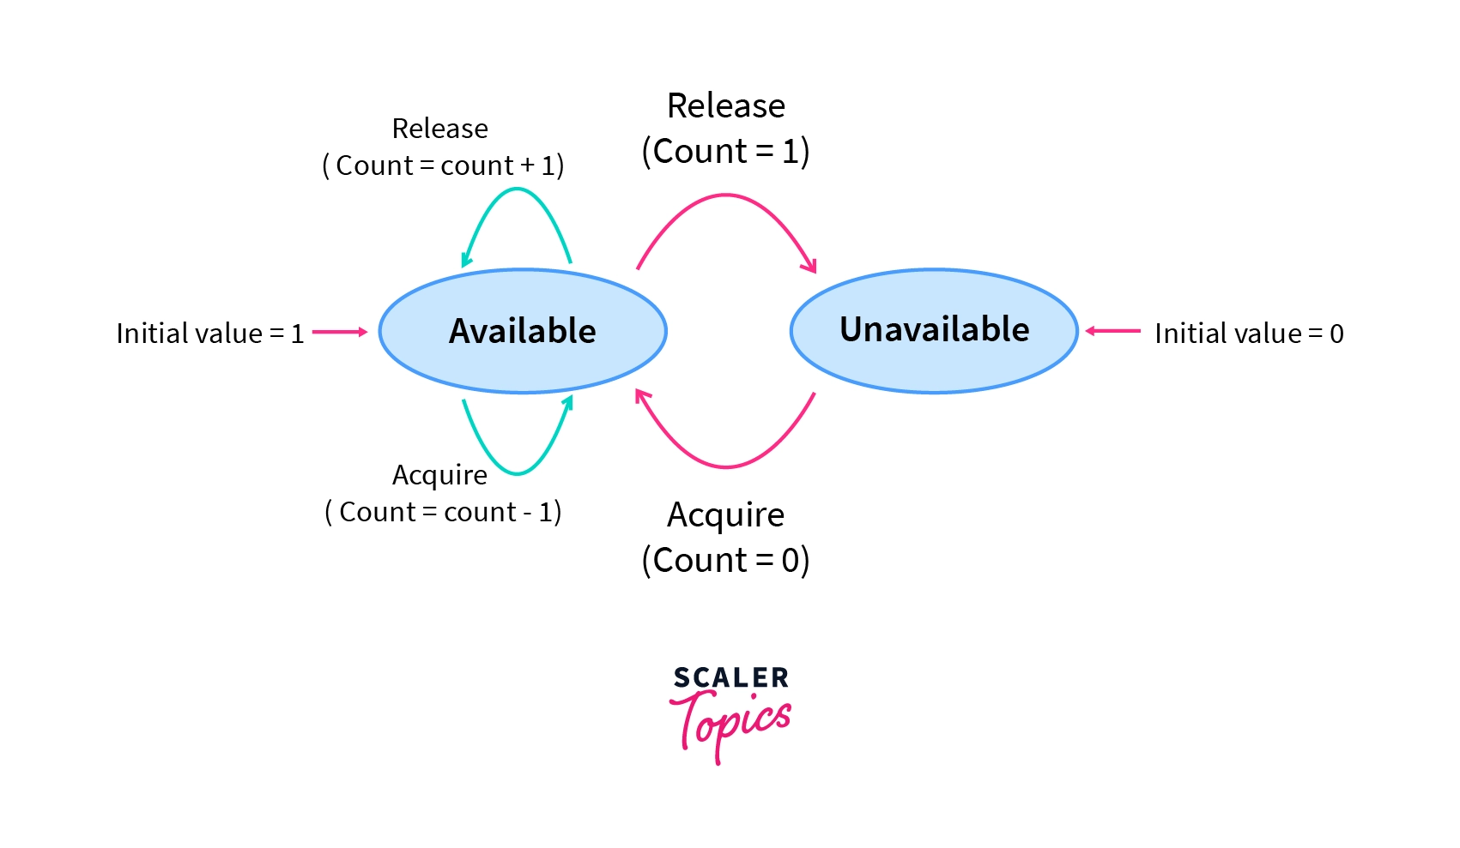
Counting Semaphores
These semaphores can take on any integer value.
If Semaphore > 0, processes can access the critical section or the shared resources.
The number of processes that can access the resources/code is the value of the semaphore.
However, if the value is 0, no resources are available or the critical section is already being accessed by a number of processes and cannot be accessed by more processes.
Counting semaphores are generally used when the number of instances of a resource is more than 1, and multiple processes can access the resource.

Slide 45
Advantages and disadvantages
Advantages of Semaphores:
Flexibility: Semaphores can be used for various synchronization tasks, beyond simple mutual exclusion.
Efficient Resource Management: Counting semaphores can efficiently control access to a fixed number of resources.
Scalability: Semaphores can be used in complex systems with multiple threads or processes.
Disadvantages of Semaphores:
Complexity: Semaphores can be more complex to use than locks, especially when dealing with multiple semaphores and complex synchronization patterns.
Deadlocks: Improper use of semaphores can lead to deadlocks, where two or more threads are waiting for each other to release resources.
Starvation: It's possible for a thread to be indefinitely delayed if other threads continuously acquire the semaphore.

Slide 46
Mutexes
A mutex (mutual exclusion lock) is a binary lock mechanism.
Only the owner thread can release it.
Think of a mutex as a lock on a door:
When one thread enters (locks it), others must wait outside.
When it finishes and unlocks, another thread can enter.
Imagine a printer shared by multiple users:
Only one user can print at a time.
Before printing, a user must acquire the mutex (lock).
After printing, the user releases the mutex (unlock) so others can print.
Purpose of Mutex:
1. To enforce mutual exclusion.
2. To prevent race conditions in concurrent systems.
3. To safely share data among threads or processes.
Notes:
A Mutex (Mutual Exclusion Object) is a synchronization mechanism used to ensure that only one process or thread can access a shared resource (like a file, variable, or critical section) at a time. It prevents race conditions, where multiple processes modify shared data simultaneously leading to inconsistent results.

Slide 47
How Mutex works ?
mutex m;
void process() {
lock(m);
// critical section
shared_data++;
unlock(m);
}
Lock (Acquire):
A thread requests ownership of a mutex before entering its critical section.
If the mutex is free, it is locked and the thread proceeds.
If it is locked, the thread waits until it becomes free.
Critical Section:
The thread performs operations on shared data.
Unlock (Release):
After finishing, the thread unlocks the mutex so that another thread can access the resource.

Slide 48
Monitors
A monitor is a high-level synchronization construct combining shared variables, procedures, and condition variables.
It combines mutual exclusion (like a mutex) and condition synchronization (like semaphores) into a single, easy-to-use abstraction
It provides a safe and structured way for threads or processes to access shared resources without interference.
Understand it as:
A monitor is like a controlled room that only one process/thread can enter at a time.
It automatically handles locking and unlocking when entering and leaving the monitor.
It uses condition variables to allow waiting and signaling between threads.
Notes:
A Monitor is a high-level synchronization construct that provides a safe and structured way for threads or processes to access shared resources without interference.
🔹 Example in Real Life:
Imagine a help desk counter:
Only one customer can interact with the staff (critical section).
If the counter is busy, others wait.
When done, the staff signals the next person to come in.

Slide 49
Structure of monitor
Shared Variables → the data or resource to be protected.
Procedures / Methods → the only way to access shared variables.
Condition Variables → used for waiting and signaling.
How it works?
When a process calls a monitor procedure:
It automatically acquires a lock to ensure mutual exclusion.
If the process must wait (because a condition isn’t met):
It waits on a condition variable.
Another process can signal that condition to wake up the waiting process.
When the procedure finishes:
The monitor automatically releases the lock.

Slide 50
Conceptual example
Advantages of Monitors:
Easier to use and understand than semaphores.
Automatically handles mutual exclusion.
Reduces programming errors (no need for explicit lock/unlock).
Encourages modular and structured synchronization.
Disadvantages:
Not available in all programming languages.
Slightly slower than low-level primitives (like semaphores).
Can still face deadlock if used incorrectly.
monitor ProducerConsumer {
int buffer;
condition full, empty;
procedure insert(item) {
if (buffer is full)
wait(empty); // wait until empty
add item to buffer;
signal(full); // signal that buffer has item
}
procedure remove(item) {
if (buffer is empty)
wait(full); // wait until full
remove item from buffer;
signal(empty); // signal that buffer has space
}
}

Slide 51
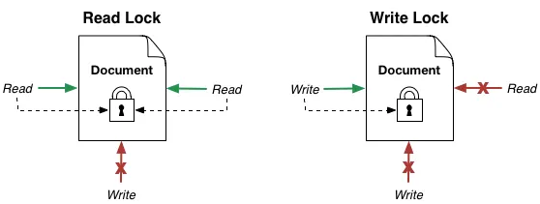
2.3.9 Avoiding Locks: Read-Copy-Update
RCU is a lock-free synchronization mechanism used to optimize read-heavy workloads.
Allows readers to access data concurrently without blocking writers.
Working Principle:
Read Phase
Update Phase
Grace Period
Reclaim Phase
Advantages:
High performance for read-mostly data.
Avoids deadlocks and reduces contention.
Use Case:
Linux kernel (network routing tables, process lists)
Notes:
Working Principle:
Read Phase: Readers access data directly (no lock).
Update Phase: Writer creates a copy of data, updates it, and replaces the old version.
Grace Period: Waits until all old readers' finish.
Reclaim Phase: Frees old data safely.

Slide 52
2.4 Process Scheduling
It is the process of deciding which process (or thread) gets to use the CPU next when there are multiple processes in the ready state.
The main goal is to maximize CPU utilization and system performance by keeping the CPU busy at all times.
The scheduler makes this decision.
Types of Schedulers
Long term(Job scheduler)
Short term (CPU scheduler)
Medium term(swapper)
Needed of process scheduling ?
1. Efficient CPU Utilization
2. Improved System Performance
3. Multitasking and Fairness
4. Adaptability to Different System Goals
5. Preventing Deadlock
Notes:
Long-term (Job Scheduler) Decides which processes are admitted to system (ready queue).
Short-term (CPU Scheduler) Decides which ready process runs next on CPU.
Medium-term (Swapper) Manages swapping of processes in and out of main memory.Occasionally

Slide 53
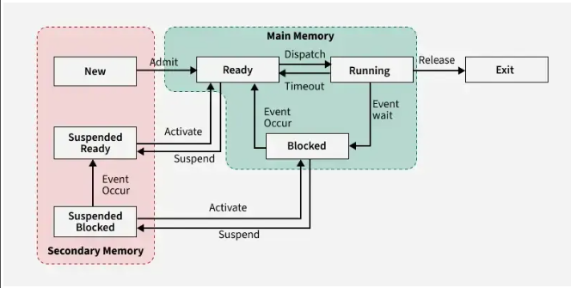
2.4.1 Basic Concept

Slide 54
2.4.2 Type of scheduling
Basis | Preemptive Scheduling | Non-Preemptive Scheduling
Definition | The CPU can be taken away from a running process before it completes its CPU burst. | Once a process starts executing, it cannot be interrupted until it finishes or waits for I/O.
Control | The operating system has control over CPU allocation. | The process itself controls CPU until it releases it.
Response Time | Usually better, as short or high-priority processes can get CPU faster. | Usually worse, since long processes block others until completion.
CPU Utilization | Higher | Lower
Overhead | High, due to frequent context switching. | Low, since context switching happens less often.
Starvation | Possible, if low-priority processes never get CPU time. | Less likely, since processes run till completion.
Used In | Systems needing real-time response (e.g., multitasking, time-sharing). | Systems where predictability is more important (e.g., batch processing).
Algorithms | RR, SRTF, Preemptive Priority. | FCFS, SJN, Non-Preemptive Priority.
Notes:
Basis Preemptive Scheduling Non-Preemptive Scheduling Definition The CPU can be taken away from a running process before it completes its CPU burst. Once a process starts executing, it cannot be interrupted until it finishes or waits for I/O. Control The operating system has control over CPU allocation. The process itself controls CPU until it releases it. Response Time Usually better, as short or high-priority processes can get CPU faster. Usually worse, since long processes block others until completion. CPU Utilization Higher, because CPU can switch to another ready process when one is waiting. Lower, because CPU may stay idle if the current process is waiting. Overhead High, due to frequent context switching. Low, since context switching happens less often. Starvation Possible, if low-priority processes never get CPU time. Less likely, since processes run till completion. Used In Systems needing real-time response (e.g., multitasking, time-sharing). Systems where predictability is more important (e.g., batch processing). Examples of Algorithms Round Robin (RR), Shortest Remaining Time First (SRTF), Preemptive Priority. First-Come, First-Served (FCFS), Shortest Job Next (SJN), Non-Preemptive Priority.

Slide 55
2.4.3 Scheduling Criteria or performance analysis
Criterion | Description
CPU Utilization | Keep the CPU as busy as possible.
Throughput | Number of processes completed per unit time.
Turnaround Time | Time from process submission to completion.
Waiting Time | Total time a process spends in the ready queue.
Response Time | Time from submission until first response is produced.
Fairness | Every process should get a fair share of CPU.

Slide 56
Performance analysis
Arrival time | Time at which process enters ready queue
Burst time | Time required by a process for CPU execution.
Completion time | The time at which the process completes its execution.
Turn around time | Time Difference between completion time and arrival time. (CT -AT)
Waiting time | Time Difference between turn around time and burst time (TAT-BT)
Response time | time at which process get cpu for the first time – arrival time

Slide 57
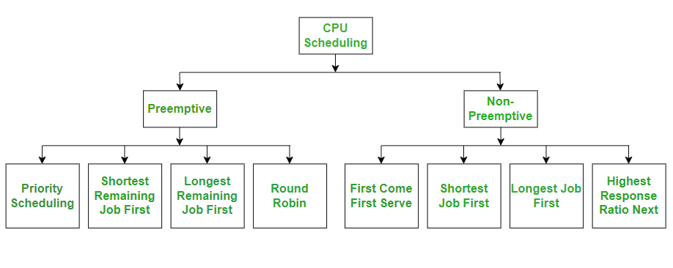
Scheduling Algorithms

Slide 58
Categories of Scheduling Algorithms
Goals
-> Fairness
-> Policy enforcement
-> Balance
Batch Systems
Throughput
Turnaround time
CPU utilixation
Interactive Systems
Response time
Proportanality
Real time Systems
Meeting deadlines
Predictability
Batch Systems
Interactive Systems
Real time Systems
Notes:
Fairness- giving all process equal share of cpu

Slide 59
First come first served (FCFS)
Jobs are executed on first come, first serve basis.
It is both non-preemptive, preemptive
Its implementation is based on FIFO queue
Advantages
Simple and easy to implement.
Fair in the sense that processes are served in order of arrival.
Disadvantages
Can cause convoy effect (short jobs wait behind long jobs).
Poor performance for interactive systems.
AWT is much higher in comparison to other approaches.
Use cases
Batch systems.

Slide 60
Numerical
Criterial: Arrival time
Non preemptive, preemptive both
Process | Arrival | Burst time | Completion time | Turn Around Time | Waiting time | Average TAT | Average WT | Response time
P1 | 0 | 5
P2 | 7 | 6
P3 | 4 | 3
P4 | 2 | 4

Slide 61
Shortest Job first (SJF)
Selects the process with the shortest Burst time.
Non-preemptive version: running process completes.
Preemptive version is called SRTF.
Advantages
Minimum average waiting time among all algorithms.
Optimal if burst times are known.
Disadvantages
Hard to predict burst time.
Starvation may occur for long processes.
Use cases
Highly controlled batch systems

Slide 62
Numerical
Criteria will be given arrival then Burst time
Non Preemtive
Process | Arrival | Burst time | Start time | Completion time | Turn Around Time | Waiting time | Average TAT | Average WT
P1 | 2 | 5
P2 | 4 | 6
P3 | 2 | 3
P4 | 5 | 4

Slide 63
Shortest Remaining Time First (SRTF)
Preemptive version of SJF
CPU is always assigned to the process with shortest remaining time.
If a new process arrives with smaller burst time, then preemption occurs.
Advantages
Further decreases waiting time compared to non-preemptive SJF.
Disadvantages
High overhead due to frequent preemption.
Long processes can suffer starvation.

Slide 64
Numerical
Criteria will be given arrival then Burst time
Preemptive
Process | Arrival | Burst time | Start time | Completion time | Turn Around Time | Waiting time | Average TAT | Average WT | Response time
P1 | 2 | 5
P2 | 4 | 6
P3 | 2 | 3
P4 | 5 | 4

Slide 65
Priority Scheduling
Each process is assigned a priority, and the process with the highest priority is executed first.
Smaller priority value = higher priority (sometimes the reverse → depends on system).
Preemptive or non-preemptive
Types of Priority:
Static Priority
Assigned at the time of process creation.
Does not change.
Dynamic Priority
Can change over time (e.g., increase the priority of waiting processes to avoid starvation).
Notes:
Non-Preemptive Priority Scheduling
CPU is assigned to the process with the highest priority.
Once a process starts running, it finishes before the CPU is given to another process.
Preemptive Priority Scheduling
If a new process with a higher priority arrives, it preempts (interrupts) the currently running process.

Slide 66
Processes with very low priority may never get CPU time. called as starvation or indefinite blocking.
Solution — Aging Increase priority of a process gradually as its waiting time increases.
Non-Preemptive
Preemptive
Start
Read the number of processes and their burst time & priority.
Sort processes based on priority (highest priority first).
Allocate CPU to the sorted processes one by one.
Compute waiting time and turnaround time.
Compute average waiting & turnaround time.
Stop
Start
At every arrival time, compare priorities of ready processes.
Select the process with the highest priority.
If new process has higher priority than current, preempt CPU.
Continue until all processes are completed.
Compute waiting & turnaround times.
Stop
Notes:
Advantages
✔ Simple to understand and implement ✔ Supports both preemptive and non-preemptive ✔ Useful when processes have different priorities (e.g., OS vs user tasks) ✔ Good for real-time systems where some tasks must run quickly
Disadvantages
✘ Starvation for low-priority processes ✘ Priority assignment can be difficult ✘ Preemptive version requires more overhead ✘ Aging must be implemented to avoid starvation
Applications
Operating systems where some tasks are more important
Real-time systems (alarm, sensors, interrupts)
Multimedia & streaming systems
Network packet scheduling
Printer/job scheduling

Slide 67
Numerical
Criteria will be given arrival then Priority time
Non -Preemptive
Process | Priority | Arrival | Burst time | Completion time | Turn Around Time | Waiting time | Average TAT | Average WT
P1 | 10 | 0 | 8
P2 | 20 | 6 | 3
P3 | 30 | 5 | 5
P4 | 40 | 8 | 7

Slide 68
Numerical
Criteria will be given arrival then Priority time
Preemptive
Process | Priority | Arrival | Burst time | Completion time | Turn Around Time | Waiting time | Average TAT | Average WT | Response time
P1 | 10 | 0 | 8
P2 | 20 | 6 | 3
P3 | 30 | 5 | 5
P4 | 40 | 8 | 7

Slide 69
Round Robin
Round Robin is one of the most popular CPU scheduling algorithms, especially used in time-sharing systems where fairness is important.
Round Robin scheduling gives each process a fixed time to execute, called the Time Quantum (or Time Slice).
The CPU cycles through the processes in a circular queue, giving every process an equal chance.
Steps
All ready processes are placed in a queue (FIFO order).
The CPU takes the first process from the queue.
The process executes for one Time Quantum (TQ).
After TQ:
If the process finishes, remove it.
If it needs more CPU time, put it at the end of the queue.
Move to the next process.
Repeat until all processes finish.
Notes:
Where is RR used?
-Windows, Linux, and macOS use Round Robin variants.
-Real-time OS (soft real-time).
-Multitasking systems where fairness is important.
Choosing Time Quantum
-Too small TQ → high overhead, slow system.
-Too large TQ → behaves like FCFS (bad for fairness).
-A good TQ makes 80% of CPU bursts finish in one quantum.
Advantages
Fairness i.e No Starvation : Every process gets CPU time.
Good for Time-Sharing Systems : Used in real OS for multitasking.
Responsive : Short tasks often finish quickly.
Simple & Easy to Implement
Disadvantages
More Context Switching: Too small TQ → many switches → overhead increases.
Not Good for CPU-bound Processes :Long processes keep waiting when many processes exist.
Average Waiting Time Can Be High: Compared to SRTF or Priority scheduling

Slide 70
Round Robin Numerical
Preemptive
Criterial: Arrival time ----Quantum
Process | Arrival | Burst time | Completion time | Turn Around Time | Waiting time | Average TAT | Average WT | Response time
P1 | 0 | 5
P2 | 7 | 6
P3 | 4 | 3
P4 | 2 | 4

Slide 71
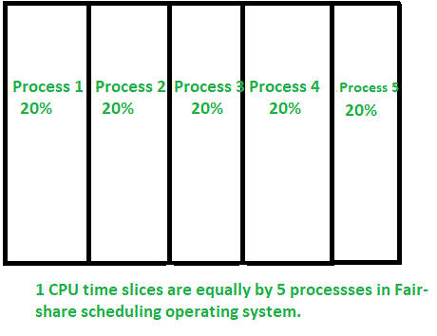
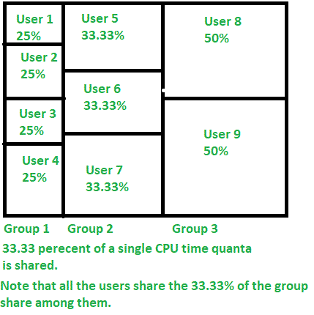
FAIR SHARE SCHEDULING ALGORITHM
First designed by Judy Kay and Piers Lauder at Sydney University in the 1980s.
It is a scheduling algorithm for computer operating systems that dynamically distributes the time quanta “equally” to its users.

Slide 72
Guaranteed Scheduling
Guaranteed Scheduling is a CPU scheduling algorithm that tries to give each process a guaranteed share of CPU time, proportional to what it should get.
If there are N processes, each gets at least 1/N of the CPU.
So, the OS tries to ensure fairness by dividing CPU time equally
Suppose N processes are running.
The OS calculates how much CPU time each process should have received.
It also keeps track of how much CPU time they actually received.
It selects the process that is most behind in its "guaranteed" CPU share.
CPU time received / CPU time expected
is kept close to 1 for all processes
Notes:
Assume 4 processes P1, P2, P3, P4.
Each should get 25% CPU.
If P3 has only received 10% so far, while others received 25%+, P3 will be scheduled next to catch up.
This ensures fair and proportional CPU distribution.

Slide 73
Why it is called “Guaranteed”?
Because the OS guarantees every process a minimum fraction of CPU time.
Unlike:
FCFS (can cause starvation)
Priority scheduling (low priority may suffer)
SJF/SRTF (long jobs suffer)
Guaranteed scheduling avoids starvation.
Notes:
Advantages
✔ Fairness : Every process gets a guaranteed CPU share.
✔ No starvation: Even lowest-priority process gets time.
✔ Predictable performance: Useful for user-level scheduling and QoS-based systems.
✔ Simple concept : (Though implementation is a bit more complex.)
Disadvantages
✖ Overhead : The OS must track CPU time expected vs actual for every process.
✖ Not optimal for interactive systems: May feel slow if too many processes share equally.
✖ Not suitable for real-time systems: Does not consider deadlines or urgency.

Slide 74
Lottery Scheduling
Lottery Scheduling is a probabilistic CPU scheduling algorithm.
Instead of fixed priorities, processes receive lottery tickets, and the scheduler randomly draws one ticket to decide which process runs next.
More tickets = Higher chance to get the CPU.
It guarantees fairness over time while allowing flexible control.
How It Works
Each process is given a certain number of tickets.
The scheduler performs a random lottery draw.
The process holding the winning ticket gets the CPU for the next time slice.
After the time slice, another lottery is drawn.
Notes:
Suppose you have three processes:
ProcessTicketsP110P220P330
Total tickets = 60
Probability of each process getting CPU:
P1 → 10/60 = 16.7%
P2 → 20/60 = 33.3%
P3 → 30/60 = 50%
P3 gets CPU more frequently because it has more tickets.
Why Lottery Scheduling?
Because it allows:
✔ Proportional Share Scheduling
CPU time is allocated proportional to the number of tickets.
✔ Flexibility
You can easily change priority by adding or removing tickets.
✔ Fairness
Over a long period, each process gets CPU time proportional to its tickets.
✔ Simplicity
No complex formulas like in EDF or RMS.

Slide 75
Research on Process and Threads
Process
Characteristics of process
PCB
IPC (what is it and its types)
Process Operation
Types of processes
Real world examples
Threads
Characteristics of Threads
Types of threads
Advantages of threads over processes
Challenges in thread programming
Real world examples
Max 50 pages
Font size 16, 14, 12
Notes:
Questions
Evaluate the impact of hardware trends such as multi-core and hyperthreading on process and thread management in modern OS design.
Discuss the advantages and limitations of modern thread libraries such as POSIX Pthreads or Java Threads. How have they evolved to support multi-core systems?

Slide 76
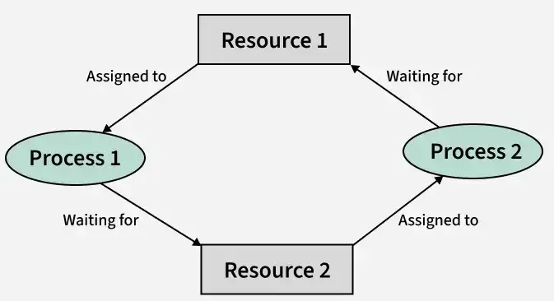
Deadlocks
A deadlock in an operating system is a situation where two or more processes are stuck forever, waiting for resources that are held by each other
Here resources can be either hardware or any piece of information in database
Process P1 holds Resource R1 and requests R2.
Process P2 holds Resource R2 and requests R1.
Neither process can proceed causing a deadlock
Notes:
Fungible resources: resources that have multiple instances that can be used interchangeably, like tape drives. Any one of free three can be used
Another example two process wants to record data from scanner
A will first ask for cd and gets it
B asks for scanner first and gets it
Now A asks for scanner but it is being used by B
And at the same time B asks for cd , and cd is being used by A, not there exists a deadlock condition

Slide 77
System Resources: Preemptable and Non-preemptable
Getting into deadlock highly depends on if the SR are preemptable or not.
A preemptable resource means resource that can be taken away from a process without causing damage or data loss
A non-preemptable resource means resource cannot be taken away from a process until the process voluntarily releases it.
Preemptable resource | Non- preemptable resource
🡪 Can be reallocated safely. OS can interrupt a process and give the resource to another process. Preemption does not harm the process | Cannot be interrupted safely. If forcibly preempted, the process may fail or corrupt data. A process must finish using the resource before another can get it.
High chances of Deadlock
High chances of Deadlock
Eg Downloading | Installing Software
Notes:
Preemptable’s example CPU (can be taken away using scheduling like Round Robin)
Main memory (pages/frames removed using paging or swapping)
Virtual memory
Registers
Why important?
Preemptable resources make it easier to avoid or recover from deadlocks because the OS can forcibly take them back.
Npn preeptable :
Printer (If you stop halfway → corrupted output)
Files being written
I/O devices
Mutex locks/Semaphores
Tape drives / CD writers
Why important?
Non-preemptable resources increase the chance of deadlocks because they must be released voluntarily.

Slide 78
All these Conditions should occur
1. Mutual Exclusion
Resources cannot be shared;
i.e. only one process can use a resource at a time.
Example: Printers, files, semaphores
2. Hold and Wait
A process is holding at least one resource and
is waiting to acquire more resources.
Conditions
3. No- preemption
A resource cannot be forcibly taken from a process.
It must be released voluntarily.
4. Circular wait
A circular chain of processes exists such that each
process waits for a resource held by the next process.
If ANY of these is broken there won’t be on deadlock anymore.
Notes:
All these Conditions should occur just like making fire: heat, fuel, oxygen, chemical reaction

Slide 79
Method of handling Deadlocks
Handling Deadlock
Just ignore the problem, and problem will ignore you
Deadlock Prevention
Deadlock avoidance
Deadlock Detection and Recovery

Slide 80
Ostrich algorithm
The OS ignores deadlocks entirely
Why?
Deadlock detection, prevention, or avoidance requires:
Extra CPU time
Extra memory
Complex algorithms
Reduced concurrency
Notes:
Ostrich Algorithm = Ignore deadlocks because handling them costs more than the rare chance they occur.
Why?
Deadlocks are rare, and cost of handling them > cost of ignoring.
If deadlock occurs:
User manually kills the process
System reboot is often the “solution”
Here Deadlock may freeze the system
Where is the Ostrich Approach used?
Windows, Linux, Unix systems
Desktop applications
General-purpose operating systems
These systems usually handle errors by:
Killing and restarting a process
Rebooting the computer
Relying on the user to notice and close programs
This is acceptable because occasional deadlocks are not critical.
Advantages
✔ No overhead of detection/prevention ✔ System becomes simpler ✔ Performance and concurrency remain high ✔ Rare deadlocks = minimal real-world impact
❌ Disadvantages
✘ If a deadlock happens, the system does not fix it ✘ User may have to restart the program or OS ✘ Not suitable for critical systems (aircraft control, medical systems)
When NOT to Use Ostrich Algorithm
Not used in systems where failure is unacceptable:
Aircraft software
Medical machines
Banking systems
Nuclear power plant systems
Real-time systems
These systems must detect and handle deadlocks.

Slide 81
Deadlock prevention
Deadlock prevention is a strategy where the operating system ensures that at least one of the four necessary conditions for deadlock never occurs.
If any one of the four conditions is eliminated, deadlock cannot happen
Mutual Exclusion
Make the resource sharable. (some resources are non sharable so preventing this is difficult and widely used)) spooling or make read only files.
Hold and Wait
Force processes to request all resources at once, before execution starts.(j j Chaiyo sab first mai magne)
OR
Require a process to release all resources before requesting new ones.(naya chaiye purano xodne)
No preemption
If a process holding some resources requests another resource that is not available:
Preempt (take back) all currently allocated resources
Put the process in waiting state
Reassign resources later
Circular wait
Impose a strict ordering of resources. Assign priority to each resources and order resources numerically
Notes:
1. Eliminate Mutual Exclusion
🡪Some resources, like a printer, are inherently non-sharable, so this condition is difficult to break. Spooling can help in managing mutual exclusion but not a complete solution.
Queuing requests: When multiple processes need to access a resource like a printer, their requests are placed in a temporary storage area called a spool.
Sequential processing: The spooler then sends these jobs to the device one by one, typically in a First-Come, First-Served (FCFS) order, ensuring that the device is not accessed by multiple processes simultaneously.
Hiding the wait: This allows the processes to submit their work quickly without having to wait for the physical device to become free. The waiting happens in the spool area, not at the actual resource, which makes the system appear more efficient.
🡪However, sharable resources like read-only files can be accessed by multiple processes at the same time.
🡪For non-sharable resources, prevention through this method is not possible.
2. Eliminate Hold and Wait
Hold and wait is a condition in which a process holds one resource while simultaneously waiting for another resource that is being held by a different process. The process cannot continue until it gets all the required resources.

Slide 82
Deadlock avoidance
It is a dynamic strategy where the operating system carefully checks each resource request before granting it.
This is done to ensure that the system never enters an unsafe state that might lead to deadlock.
How Deadlock Avoidance Works
Whenever a process requests some resources, the OS:
Pretends to allocate the resources (temporary allocation)
Checks if the system would still remain in a safe state with this allocation
If safe, the OS grants the request
If unsafe, the OS denies or delays the request
This requires:
Knowledge of current allocation
Knowledge of future maximum needs

Slide 83
Deadlock Avoidance Algorithms
Banker's Algorithm (Multiple Resource Instances)
Resource Allocation Graph (RAG)
Used when:
Only one instance per resource type exists.
How it works:
Add a claim edge Pi → Rj, meaning process Pi may request Rj in future.
If Pi actually requests Rj:
The claim edge becomes a usual request edge
Before granting:
The OS checks whether converting that request edge to an assignment edge will create a cycle.
I f a cycle is created → deny request (unsafe)If no cycle → grant request (safe)
If a cycle exists → unsafe → risk of deadlock.
Used when:
There are multiple instances of resource types
Each process declares maximum resource needs
Banker’s Algorithm Data Structures
Available[m] – how many instances of each resource type are free.
Max[n][m] – maximum demand of each process.
Allocation[n][m] – currently allocated resources.
Need[n][m] = Max – Allocation – what each process still requires.

Slide 84
Banker’s Algorithm
When a process requests resources:
Check if Request[i] <= Need[i]
If not then error.
Check if Request[i] <= Available
If not then P[i ]must wait.
Pretend to allocate resources:
Run the Safety Algorithm:
Try to find a safe sequence
Check whether all processes can eventually finish
If safe sequence exists then Grant the request
If not safe then Roll back temporary allocation and deny the request

Slide 85
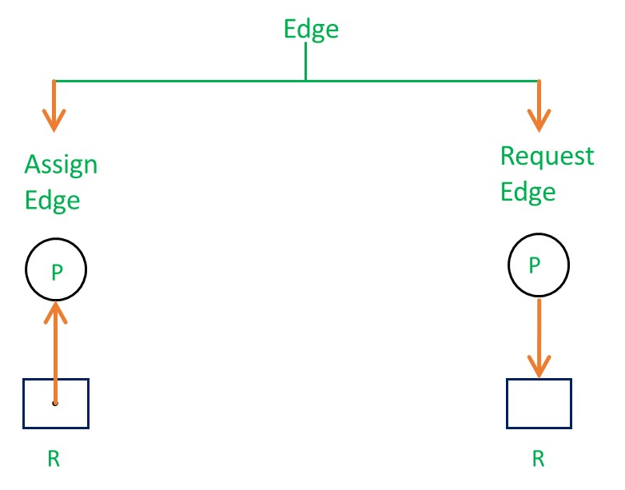
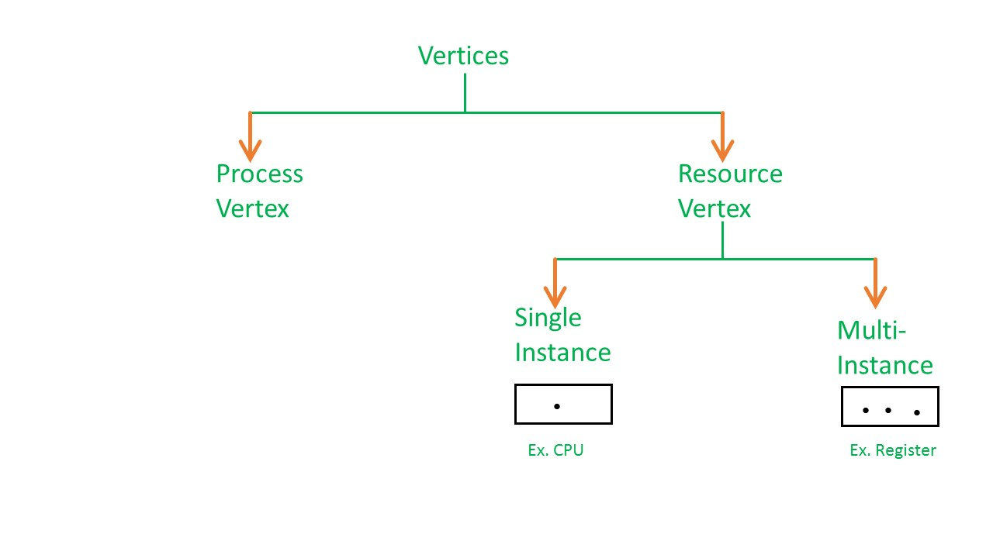
Resource Allocation Graph (RAG)
A resource allocation graphs shows which resource is held by which process and which process is waiting for a resource of a specific kind

Slide 86
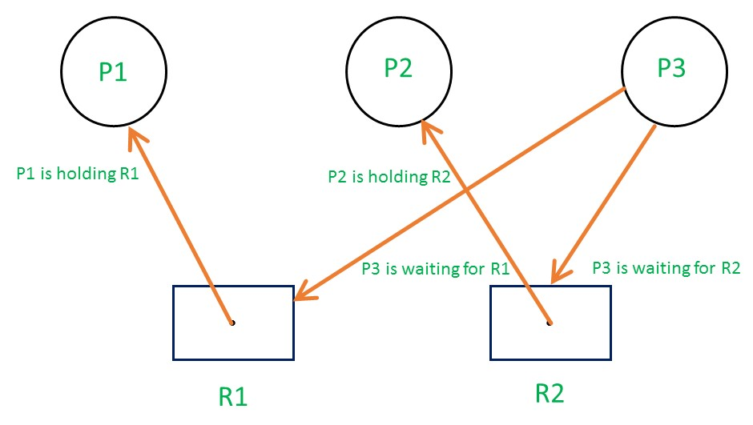
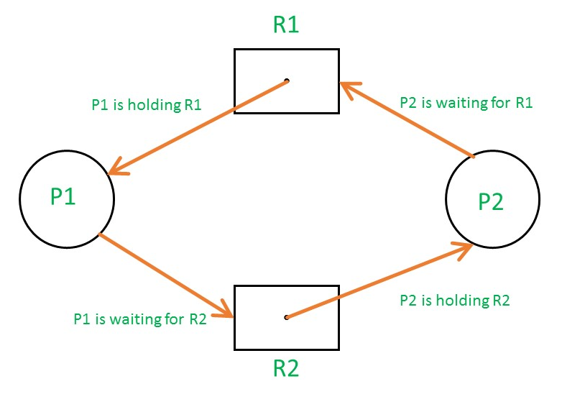
Single instance
Which one is in deadlock ?

Slide 87
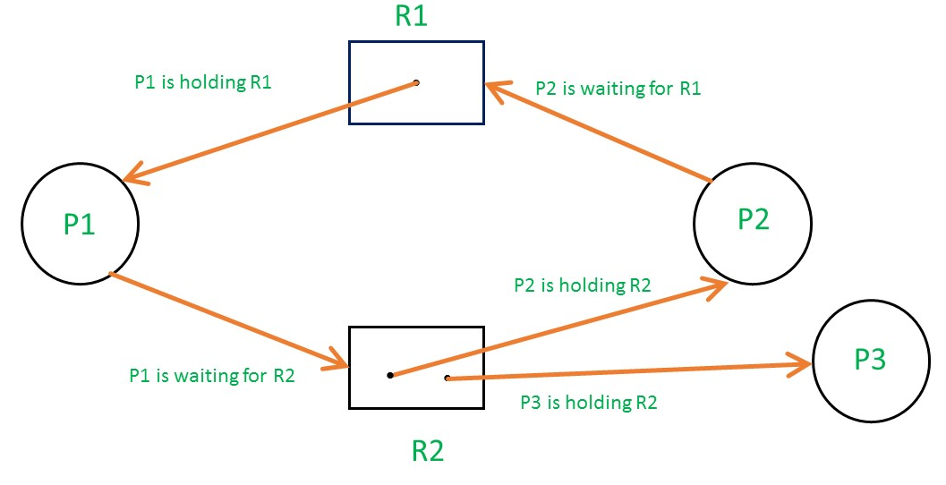
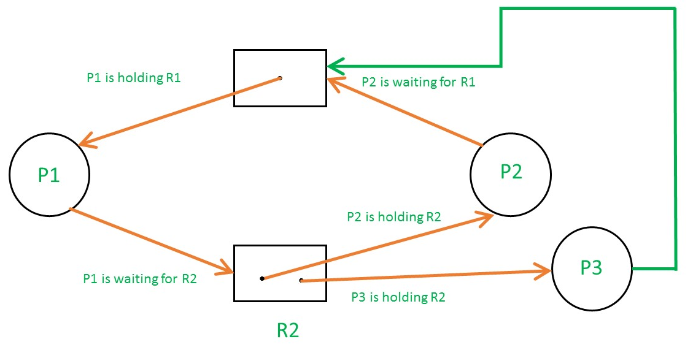
Multi instance RAG
Which one is Results in deadlock ?
Find the sequence that don’t result in deadlock

Slide 88
Deadlock Detection and Recovery
Reallocate requested resources when they are released
is
Deadlock
?
Yes
Recover Somehow
No
Got safe sequence

Slide 89
Deadlock Detection and Recovery
The operating system periodically checks the system's state to see if a deadlock has occurred.
Resource Allocation Graph (RAG)
A deadlock is identified if a cycle exists in the resource allocation graph.
Matrix-based algorithms:
with multiple instances of resource types, algorithms using matrices and vectors (like Work and Finish) are used to detect deadlocks.
Deadlock recovery
Process termination
Resource preemption:
Process rollback:
Notes:
Deadlock detection
Mechanism:
The operating system periodically checks the system's state to see if a deadlock has occurred.
Techniques:
Resource Allocation Graph (RAG): For systems with a single instance of each resource type, a deadlock is identified if a cycle exists in the resource allocation graph.
Matrix-based algorithms: For systems with multiple instances of resource types, algorithms using matrices and vectors (like Work and Finish) are used to detect deadlocks.
Deadlock recovery
Once a deadlock is detected, the system must resolve it. Common recovery methods include:
Process termination
Process termination
Abort one process at a time: The system aborts processes one by one until the deadlock is broken. This can be inefficient as it requires re-checking for deadlocks after each termination.
Abort all deadlocked processes: All processes involved in the deadlock are terminated, which is guaranteed to break the cycle but is costly and may result in lost work.
Resource preemption:
The system takes a resource away from one of the deadlocked processes and gives it to another process to break the circular wait. This process must be carefully managed to ensure the safety of the system.
Process rollback:
A process is rolled back to a previous, consistent state where it did not cause a deadlock. This requires a mechanism to checkpoint and restart processes from that point.

Slide 90
Protection
System protection refers to the mechanisms used by an operating system to prevent unauthorized or improper use of system resources.
It ensures that processes do not interfere with each other or with the OS itself.
Protection is required for:
Files
Memory
CPU time
I/O devices
System data/OS kernel
It prevents:
Accidental errors
Malicious attacks
Resource misuse
Notes:
System protection refers to the set of mechanisms, policies, and controls implemented by an operating system (OS) to safeguard system resources from unauthorized, unintended, or harmful use. These protections ensure that programs, users, and processes operate safely without interfering with one another or damaging the system.
1. What is System Protection?
System protection is a fundamental OS function that:
Controls access to system resources
Ensures that each process uses only the resources it is permitted to use
Prevents processes from affecting the operation of other processes
Ensures the security and stability of the operating system
In simple terms, it is the OS’s job to protect the system from misuse—intentional or accidental.
2. Why is System Protection Needed?
Operating systems support multiple users and processes running simultaneously. Without protection:
A faulty process could corrupt memory.
A malicious program could destroy files.
Unauthorized users could steal data.
A process could monopolize CPU or I/O resources.
Thus, protection ensures reliability, security, and controlled access.
3. Resources That Require Protection
The OS must protect several types of resources:
✔ 1. Files
Prevent unauthorized reading, writing, modification, or deletion.
Enforce permissions (Read, Write, Execute).
Use file access control lists (ACLs), file modes, encryption.
✔ 2. Memory
Each process should have its own protected memory space.
Prevents:
Accessing memory of other processes
Overwriting OS memory
Buffer overflows
Implemented using paging, segmentation, memory bounds registers.
✔ 3. CPU Time
Prevent one process from monopolizing CPU.
Scheduler ensures fair allocation.
Protection prevents:
Infinite loops blocking the CPU
Starvation of other processes
✔ 4. I/O Devices
Ensures only authorized processes use devices like printers, disks, network cards.
Device drivers + I/O permissions handle this.
✔ 5. System Data / OS Kernel
Kernel is the heart of the OS; corruption would crash the system.
Kernel mode of execution protects critical instructions.
Only OS can execute privileged operations.
4. What Does System Protection Prevent?
System protection mechanisms prevent both accidental errors and intentional misuse:
✔ 1. Accidental Errors
Examples:
A buggy program modifying memory of another program.
A user accidentally deleting system files.
A process stuck in an infinite loop blocking CPU.
Protection mechanisms ensure these errors do not affect system stability.
✔ 2. Malicious Attacks
Examples:
Malware attempting to read or destroy files.
Unauthorized network access.
Privilege escalation attacks (gaining admin/root access illegally).
Protection stops attackers and restricts capabilities.
✔ 3. Resource Misuse
Examples:
A process consuming all CPU or memory.
A user using a shared printer without permission.
A program flooding the OS with I/O requests.
System protection guarantees that resources are used fairly, securely, and efficiently.
5. How the OS Implements Protection
Operating systems use a combination of mechanisms:
✔ 1. Hardware Protection
CPU modes: User Mode and Kernel Mode
Memory protection: base and limit registers, paging, segmentation
Privileged instructions reserved for OS
✔ 2. Access Control Mechanisms
Access control lists (ACLs)
Access matrix model
Role-based access control
Permissions (Read, Write, Execute)
✔ 3. Authentication and Authorization
Login/passwords
Tokens, biometrics
User roles and privileges
✔ 4. Process Isolation
Each process runs in its own protected memory space.
No direct access to other processes.
✔ 5. File System Protection
Permission bits, ownership
Encryption
Secure file access APIs
6. Goals of System Protection
The OS protection system aims for:
✔ Correctness
Programs behave as intended.
✔ Preventing Interference
Processes do not interfere with other processes or OS.
✔ Controlled Access
Only allowed operations are permitted.
✔ Reliability
System continues functioning even if faults occur.
✔ Security
Protection from unauthorized access and attacks.
System protection is essential to ensure:
Security
Stability
Fair resource usage
Isolation of processes
Protection of critical system components
It safeguards files, memory, CPU, I/O devices, and the OS kernel, preventing accidental errors, malicious attacks, and misuse of system resources.

Slide 91
Goals of Protection
The main goals are:
Confidentiality: Only authorized users/processes should access the information.
Integrity: Data should not be modified by unauthorized users.
Availability: Authorized users must get access to resources whenever required.
Safety: System should protect resources from harmful operations.
Controlled Sharing: Allow only safe, defined sharing between users and processes.
Reliability – Keep system stable and predictable.
Notes:
1. Confidentiality
Confidentiality ensures that information is not disclosed to unauthorized users.
What it means:
Only authorized processes/users can view data.
Others should not even know the data exists.
Examples:
A student should not see another student’s marks.
Password files should not be readable by normal users.
Banking software should hide account details from unauthorized people.
Why important?
Prevents privacy violations, data leakage, and exposure of sensitive information.
2. Integrity
Integrity protects data from unauthorized modification, damage, or deletion.
What it means:
Data must remain accurate and consistent.
Only authorized users can modify objects.
Examples:
A record in a database must not be altered by unauthorized code.
A program cannot modify OS kernel memory.
A virus should not change system files.
Why important?
Prevents corruption, tampering, and malicious changes.
3. Availability
Availability ensures that authorized users can access resources whenever needed.
What it means:
System resources (CPU, memory, files, printers) must be available to legitimate processes.
Protection mechanisms must not block permitted users.
Examples:
Preventing Denial-of-Service (DoS) attacks.
Ensuring CPU scheduling gives fair access.
Avoiding deadlocks so processes get resources on time.
Why important?
Prevents resource starvation, downtime, and service denial.
4. Maintainability / Safety
(Also called safety in some textbooks)
Safety ensures that the system is not harmed by wrong or illegal operations.
What it means:
Protection should prevent operations that could damage resources.
The system should continue working even when parts fail.
Examples:
A user should not delete a system file accidentally.
A process should not overwrite memory belonging to another process.
A faulty program should not crash the entire OS.
Why important?
Avoids system crashes, resource damage, and accidental errors.
5. Controlled Sharing
Protection should allow safe and controlled sharing of resources among users and processes.
What it means:
Resources can be shared, but only in a regulated manner.
OS controls how, when, and who can use shared objects.
Examples:
File sharing with read-only permissions.
Two processes sharing memory using access rights.
Controlled program execution with user-level and kernel-level modes.
Why important?
Prevents conflicts, race conditions, and security breaches in shared systems.
6. Reliability
Some books include reliability as a goal.
What it means:
System should continue working correctly even under unexpected conditions.
Protection mechanisms contribute to stability.
Examples:
Protection prevents malicious code from crashing OS.
Ensures consistent system behavior.

Slide 92
Principles of Protection
Protection principles are guidelines used to design a secure operating system. They ensure that the system is safe, secure, and resistant to misuse or attack.
Least Privilege
Every process/user should be given only the minimum privileges needed
Need-to-Know Principle
Access is granted only when it is required for a specific task.
Separation of Privilege
Access should require more than one condition (two-factor checks).
Fail-Safe Defaults
By default, access should be denied, not allowed.
Complete Mediation
Every access to every resource should be checked by OS.
Economy of Mechanism
Security design should be simple and easy to verify.
Notes:
.Example: A program that prints files should not delete files.
Principles of Protection
Protection principles are guidelines used to design a secure operating system. They ensure that the system is safe, secure, and resistant to misuse or attack.
Below are the most important principles:
1. Principle of Least Privilege
A process/user should be given only the minimum privileges required to perform its task, nothing more.
Why?
Reduces damage if a program goes wrong.
Minimizes attack surface.
Examples:
A text editor should have access only to files it edits, not system files.
A web browser should not modify kernel files.
Bank employees can view customer data but cannot delete accounts.
2. Principle of Need-to-Know
Access is granted only when a process absolutely needs the information to perform its task.
Why?
Prevents unnecessary exposure of data.
Examples:
A user who needs to print a document should not get access to read other users’ files.
A payroll program needs employee salary data but not HR department notes.
3. Principle of Separation of Privilege
A system should require two or more conditions for granting access. (No single permission should be enough.)
Why?
Makes unauthorized access much harder.
Examples:
Two-password systems (admin + root).
ATM withdrawal requires both:
Your bank card
Your PIN
Installing software on macOS requires:
Admin password
User confirmation
4. Principle of Complete Mediation
Every access to every resource must be checked by the operating system without exception.
Why?
Prevents backdoor access or bypassing checks.
Examples:
File access should be checked every time a program reads/writes it.
Cache should not bypass permission checks.
Kernel verifies I/O operations on each request.
5. Principle of Fail-Safe Defaults (Default Deny)
The default action should be to deny access, not allow. Access must be explicitly granted.
Why?
Prevents accidental access.
Reduces risk from misconfiguration.
Examples:
New files in Linux: permissions = "deny for others" by default.
Firewall: blocks all ports unless opened manually.
Bank accounts: no transaction rights until assigned.
6. Principle of Economy of Mechanism (Simplicity)
The protection system should be small, simple, and easy to verify.
Why?
Complex systems have more bugs.
Easier to test and maintain.
Examples:
Simple permission bits (r, w, x) in UNIX.
Minimal code for authentication to avoid vulnerabilities.
Avoiding unnecessary modules in OS kernels.
7. Principle of Least Common Mechanism
Shared mechanisms should be minimized. Sharing increases the risk of interference.
Why?
Shared code/resources create security risks.
Examples:
Avoiding shared global variables between processes.
Each user having separate session data.
Avoiding shared memory unless necessary.
8. Principle of Psychological Acceptability
Protection mechanisms should be easy to understand and use. If too complex, users will find ways to bypass them.
Why?
Security should not reduce usability.
Examples:
Easy and clear permission settings.
Simple login and two-factor authentication.
Windows UAC prompts that explain actions clearly.

Slide 93
Domain of Protection
A domain defines what a process is allowed to access.
A domain consists of:
A set of objects (files, memory, devices)
A set of rights (read, write, execute, create, delete)
Domains can be:
User-based (each user has a domain)
Process-based (each process has its own domain)
Object-based (rights are attached to objects)
Processes can switch between domains when required (mode switching).
Notes:
The Domain of Protection defines the set of resources (objects) and the access rights a process (subject) can use at any given time.
It acts like a boundary that decides:
What a process can access
What a process cannot access
A domain is basically a protection environment for a process.
1. What is a Domain?
A domain is a collection of:
Objects (files, memory segments, devices, etc.)
Access Rights (read, write, execute, etc.)
So,
Domain = Set of Objects + Set of Rights
A process running in a specific domain can only use the rights defined in that domain.
2. Purpose of Domains
Domains help:
Control what each process can do
Protect system resources
Prevent processes from interfering with each other
Isolate users, programs, and system components
3. How Domains Work
Imagine it like this:
When a process runs, it is placed in a domain.
That domain defines what the process is allowed to do.
OS changes domains when needed (domain switching).
4. Domain as a Logical Boundary
A domain acts like a sandbox or secure environment.
Example:
When you run your browser → It has limited access rights.
When you run a kernel process → It has full rights (privileged).
This difference is because they operate in different domains.
5. Representation of Domains
Domains can be represented in two ways:
A. User-Based (Static) Domains
Each user has a domain.
User1 domain: rights to their own files
User2 domain: rights to their files
Admin domain: full rights
These rights do not change frequently — hence static.
B. Process-Based (Dynamic) Domains
Each process has its own domain.
Different processes of the same user may have different rights.
Example:
Your text editor process: read/write your files
A game process: only execute rights, no file access
A banking app process: access only its secure data
Domains change when:
A new program runs
User switches mode (user mode ↔ kernel mode)
System calls change access levels
6. Domain Switching
A crucial concept.
A process may need to switch domains during execution.
Why?
Because different tasks need different permissions.
Example:
A user program reads a file → User Domain
It makes a system call (I/O request) → OS switches to Kernel Domain
After completing the call → Switches back to User Domain
This ensures:
Safety
Privilege separation
Controlled access
7. Domain as Rows in Access Matrix
In the Access Matrix:
Rows represent domains
Columns represent objects
Entries specify access rights
So domain of protection is directly related to the access matrix model.
Example:
Domain / ObjectFileAFileBPrinterD1readwrite—D2—readprint
If process is in D1, it can:
read FileA
write FileB
cannot use printer
If process is in D2, it can:
read FileB
print
cannot touch FileA
8. Examples of Domains (Real Life OS)
1. User Mode vs Kernel Mode
User Mode → limited rights
Kernel Mode → full rights
2. Linux File Permissions
Owner Domain
Group Domain
Others Domain
Each domain has its own rights.
3. Java Virtual Machine (JVM) Sandbox
Applets run in restricted domains
Cannot access local files unless permitted
4. Browser Sandbox
Every browser tab runs in its own domain.
9. Key Advantages of Domains
Strong isolation
Better security
Prevent unexpected access
Supports least privilege principle
Easier permission management
Exam-Ready Short Notes on Domain of Protection
Domain of Protection defines the set of objects and access rights available to a process.
It acts as a protection boundary that controls what a process can do.
Domains may be user-based (static) or process-based (dynamic).
Domain switching allows a process to move between different permission levels.
In the Access Matrix, domains correspond to rows representing rights.
Domains help implement least privilege and secure execution environments.

Slide 94
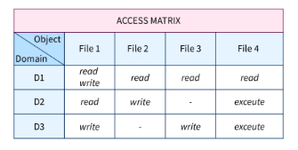
Access Matrix
The access matrix is a model that represents who can access what.
The matrix provides a conceptual framework for protection mechanisms.
It is a two-dimensional matrix:
Rows = Subjects (users/processes/domains)
Columns = Objects (files/devices/memory)
Entries = Rights (read, write, execute)
Notes:
Access Matrix: It is a two-dimensional logical structure used to define the rights of subjects to objects. Rows represent subjects, columns represent objects, and each entry defines set of operations allowed on that object.
It is a conceptual model for implementing protection using:
Access Control Lists (ACL)
Capability Lists (C-Lists)
Lock-key mechanisms
It helps achieve confidentiality, integrity, and controlled sharing in an OS.

Slide 95
Implementation of Access Matrix
Notes:
The access matrix is theoretical; implementing a full matrix is too large. So OS uses practical implementations:
1. Global Table
A table of tuples: (subject, object, rights) Simple but becomes large and slow.
2. Access Control Lists (ACL)
Stored per object. Each object has a list:
“Who can access it, and with what rights?”
Example (File A ACL):
User1 → read
User2 → write
User3 → read, execute
Best when there are few subjects per object.
3. Capability Lists (C-List)
Stored per subject/domain. Each subject keeps a list of objects it can access with rights.
Example (Process P Capability List):
File A → read
Printer → print
Best when each subject accesses few objects.
4. Lock-Key Mechanism
Objects have locks
Subjects have keys If key matches lock → access granted.
Used in secure systems and hardware-based protection.

Slide 96
Access Control List (ACL)
An ACL is a list attached to an object specifying what each user/process is allowed to do.
It is a direct implementation of access matrix column.
Each object has entries like:
User/Group name
Allowed permissions (r, w, x)
There are two types of ACLs
Standard Access-list
Extended Access List
Benefits:
Easy to manage per object
Good for filesystems
Supports group-based permission
Limitations:
Long lists if many users
Hard to manage in large systems
Notes:
There are two main different types of Access-list namely:
Standard Access-list - These are the Access-list that are made using the source IP address only. These ACLs permit or deny the entire protocol suite. They don't distinguish between the IP traffic such as TCP, UDP, HTTPS, etc. By using numbers 1-99 or 1300-1999, the router will understand it as a standard ACL and the specified address as the source IP address.
Extended Access-list - These are the ACL that uses source IP, Destination IP, source port, and Destination port. These types of ACL, we can also mention which IP traffic should be allowed or denied. These use range 100-199 and 2000-2699.

Slide 97
Questions

